Slide 1
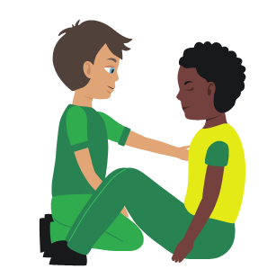
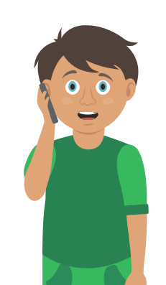

Starter Activity
Minor head injuries
Use your current first aid knowledge to explain what you could do for each of the 4 steps.
Step 1.
Step 2.
Help your c_ _ _ _ _ _ _ to sit down
Apply a cold c_ _ _ _ _ _ _ to the injured area
Treat any w_ _ _ _ _
Step 3.
Step 4.
Monitor your casualty
Watch for d_ _ _ _ _ _ _ _ _
and v_ _ _ _ _ _ _
Get help if necessary
Make sure a r_ _ _ _ _ _ _ _ _ _ adult stays with the casualty
Notes:
Teacher demonstrates then gets the students to practice using either the PP slide as a prompt or the sheet in the workbook. Teacher circulate and correct as necessary
Severe head injury to be covered with severe bleeding

Slide 2
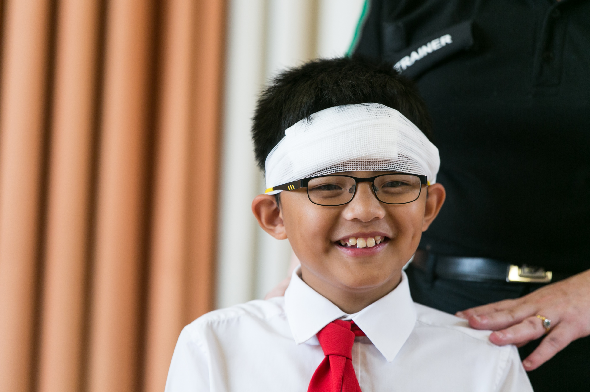


Head injuries
KS2 – Head Injuries

Slide 3
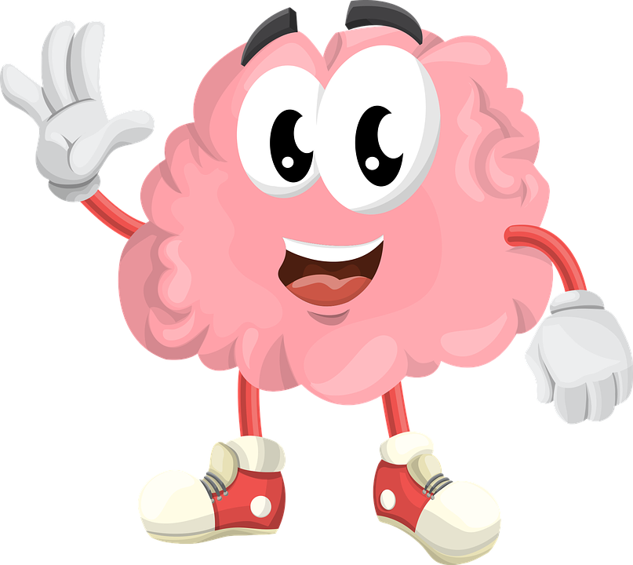
Head injuries
A short course to learn how to help someone who has a head injury.

Slide 4
Learning outcomes
I can identify a minor or major head injury
I can give first aid to a casualty who has a head injury
I can call for help for a casualty who has a head injury
Notes:
Teacher should refer to ground rules for the session at this stage

Slide 5
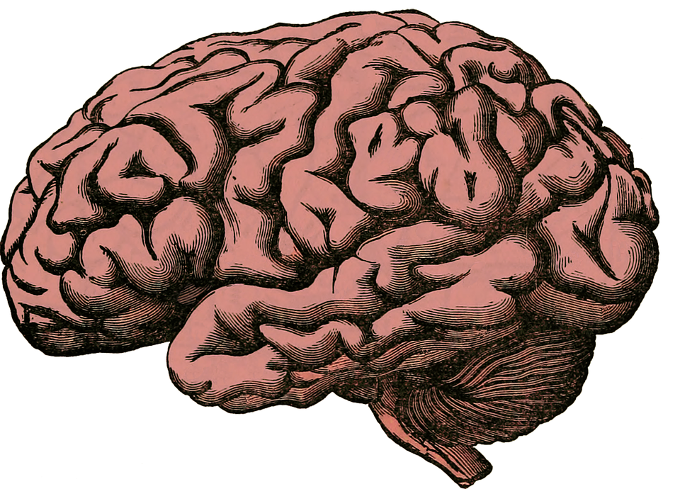
Brain facts
1. The human brain is like a powerful computer that operates the body.
2. It stores memories and controls how we move, think and react.
3. It keeps working, even when we are sleeping.
4. The brain is protected by the skull.
5. It uses 1/5 of our bodies energy.

Slide 6
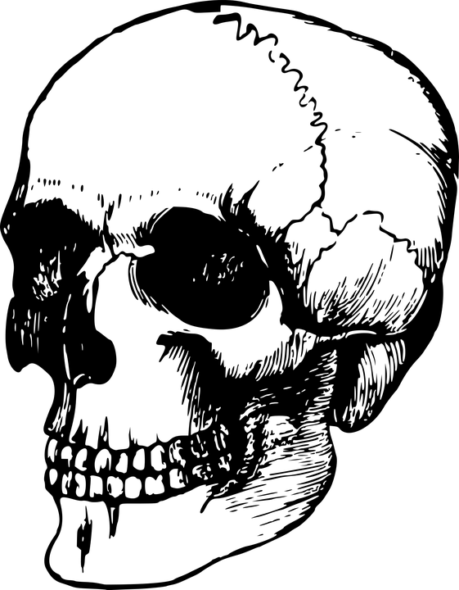
Skull facts
1. The skull (cranium) protects the brain (the brain is inside of it).
2. The human skull is made up of 22 different bones.
3. The muscles that enable us to make different facial expressions attach to the skull.
4. Being male or female, and your race, will affect the size and shape of your skull.
5. The jawbone is the only part of the skull that moves.

Slide 7
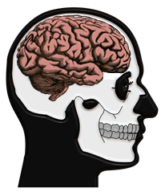
The brain
The brain is extremely delicate, so it sits inside the skull for protection.
The brain is the control centre for our body, controlling our awareness, our decisions, our movements, our breathing and the heart.
An injury to the head can lead to dangerous damage to the brain.
Notes:
Discuss the image of skull protecting the brain.
Think of all the things that the brain controls, explain that in case of severe head injury, these could be affected.

Slide 8
Activity A18
What does the brain do? do?
Students now can demonstrate their knowledge regarding functions of the brain. Use our downloadable worksheet A18 which can be found on the St John Ambulance website.
Notes:
Optional activity

Slide 9
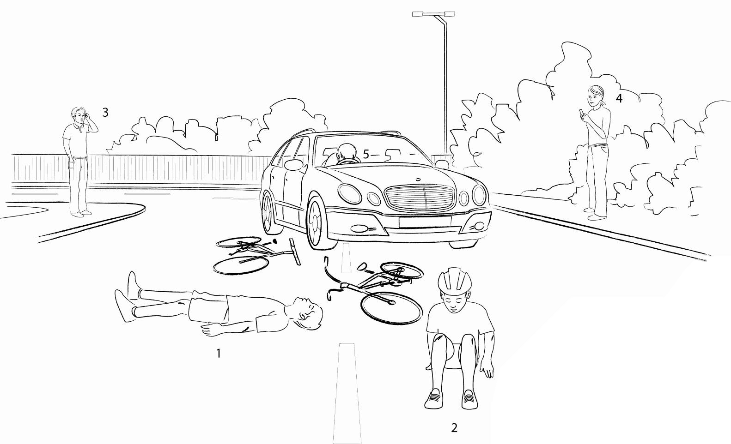
What do you see? A19
What do you see? Who could have a head injury? Explain your answer.
Notes:
What do you see? Discuss points numbered 1-5
Not wearing helmet v wearing helmet
Driver - head on steering wheel (seatbelt)
Discuss head injury possible in two instances i.e. when cyclist first hits car and then hits the floor!
Accident prevention advice - wear a helmet!

Slide 10
Mild V Severe
Signs of a MILD head injury could be:
Wound to head
Dizziness and/or feeling sick
Confusion
Mild headache
Level of response may be affected for a brief period
Loss of memory at the time or immediately before the injury
REMEMBER a mild head injury could become worse
Signs of a SEVERE head injury could be:
History of severe blow to the head
Declining level of response.
Casualty may become unresponsive.
Blood or bloodstained watery fluid leaking from ear or nose
Unequal pupil size
Notes:
If bleeding or swelling in brain then what seems a mild head injury initially could become a severe head injury.

Slide 11
Seeking medical advice
Which of the following do you think you should seek medical advice for?
Difficulty speaking and/or walking
Confusion
Drowsiness that is getting worse
Double vision
A headache that is not getting better
Loss of memory and/or dizziness
Vomiting
Seizure (fitting)
Notes:
Answer ALL of them!
All are signs of worsening head injury so if any of these signs are evident you MUST seek medical help.

Slide 12
Your turn:
Minor head injury
1. Help your casualty to sit down
2. Apply a cold compress to the injured area
Treat any wounds
3 . Monitor your casualty
Watch for drowsiness and vomiting
4. Get help if necessary
Make sure there is a responsible adult to stay with them
Notes:
Scenario cards are available which the teacher can use to make the practical activity relevant in a certain context for students.
Teacher demonstrates then gets the students to practice using either the PP slide as a prompt or the sheet in the workbook. Teacher circulate and correct as necessary
Severe head injury to be covered with severe bleeding

Slide 13
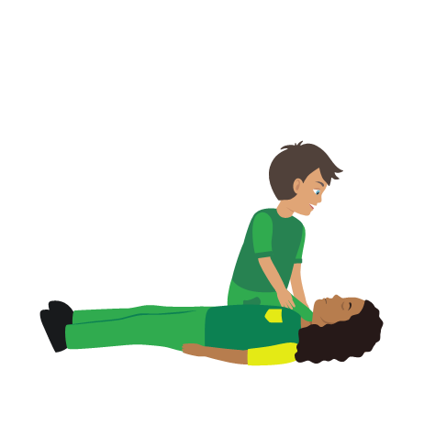
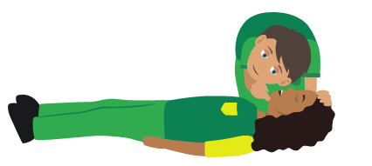
Your turn:
Severe head injury
1. Dial 999/112 for emergency help
2. Do NOT move your casualty if you suspect they could have a neck injury
3. Make sure the airway is open
4. Treat any serious wounds
5. Monitor casualty until emergency help arrives
Notes:
Scenario cards are available which the teacher can use to make the practical activity relevant in a certain context for students.
Teacher demonstrates then gets the students to practice using either the PP slide as a prompt or the sheet in the workbook. Teacher circulate and correct as necessary
Severe head injury to be covered with severe bleeding

Slide 14
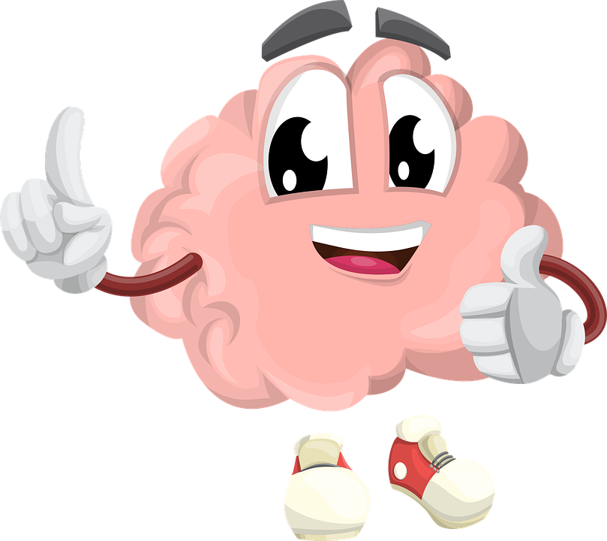
Quiz time
1. Name one sign of a head injury
2. Name one way to prevent a head injury
3. Name the part of the body which protects the brain
4. How many bones form the skull?
5. Name one thing that the brain controls
6. How would you treat a head injury? (Minor and severe)

Slide 15
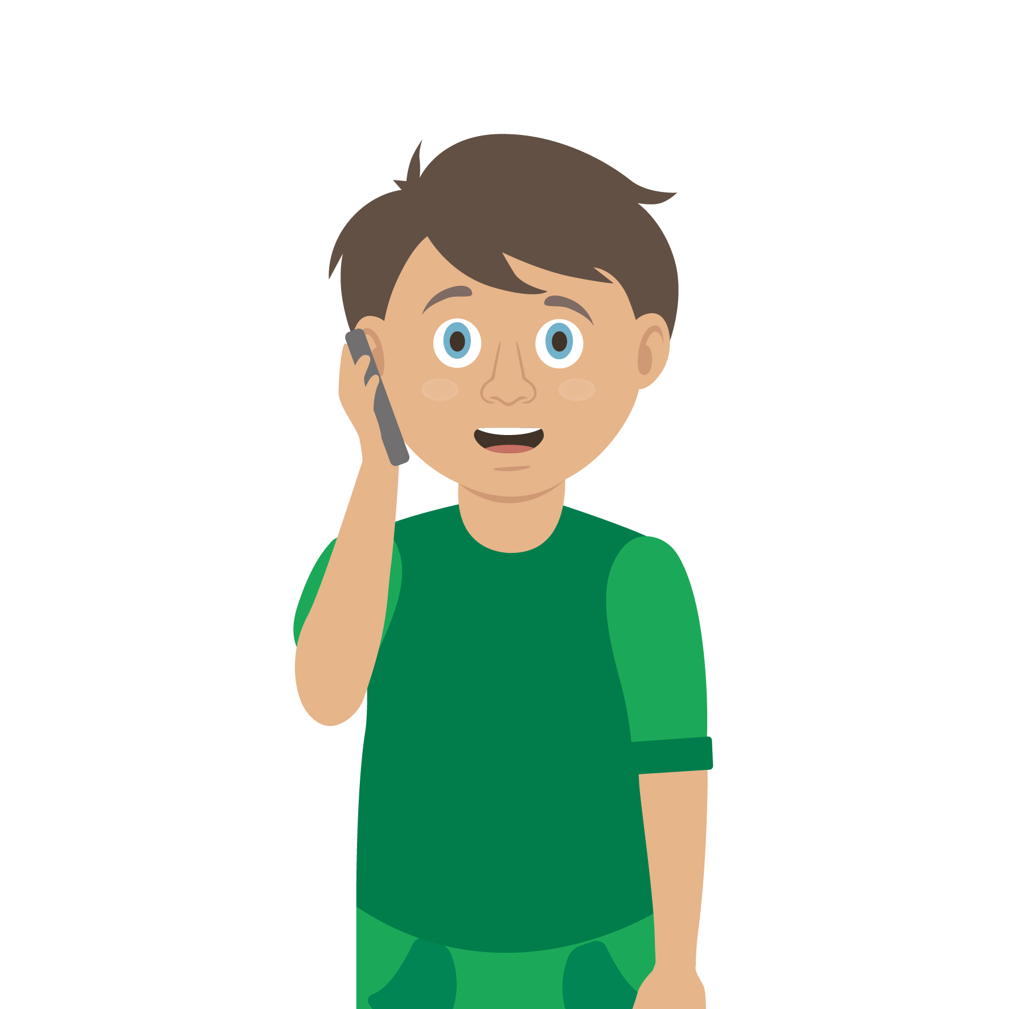
Casualty care
Pause for thought...
Which actions do you think are most important when caring for a casualty?
Get help
No food or drink
Prevent condition worsening
Remain calm
Keep warm
Treat with dignity and respect
Reassure casualty
Communicate well
Notes:
Opportunity to discuss common casualty care skills which are necessary in all first aid situations.

Slide 16


Check your learning
I am able to:
Identify a minor of head injury
Give first aid to a casualty who has a head injury
Call for help for a casualty with a head injury
YES NO

Slide 17

Information and support
If any of the content in this session has upset or concerned you please discuss this with one of the teachers at your school
Further support can be found at:
www.childline.org.uk
www.youngminds.org.uk
www.samaritans.org
Further information linked to first aid can be found at:
www.sja.org.uk
www.asthma.org.uk

Slide 18

Thank you!

Slide 19


Activity A1
Keeping safe
Think of things we could do that may help prevent head injuries from happening.
Can you design and create a poster that shows people how they can keep safe and potentially avoid getting a head injury?

Slide 20


Optional activity A2
Skull design
Time to get creative. The class can now design their own colourful paper skull. Turn them in to masks or make an amazing classroom display. Use our downloadable worksheet which can be found on the St John Ambulance website.

