Slide 1
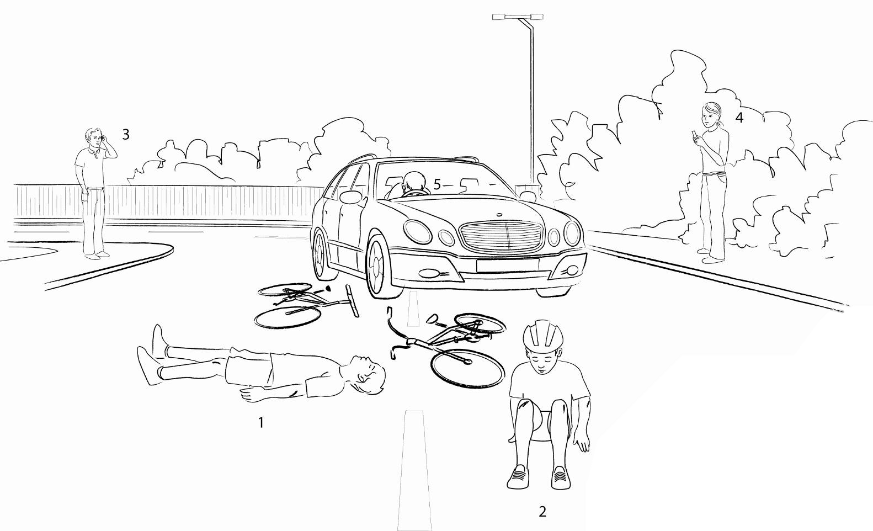
What do you see? A19
What do you see? Who could have a head injury? Explain your answer.
Notes:
What do you see? Discuss points numbered 1-5
Not wearing helmet v wearing helmet
Driver - head on steering wheel (seatbelt)
Discuss head injury possible in two instances i.e. when cyclist first hits car and then hits the floor!
Accident prevention advice - wear a helmet!

