Slide 1
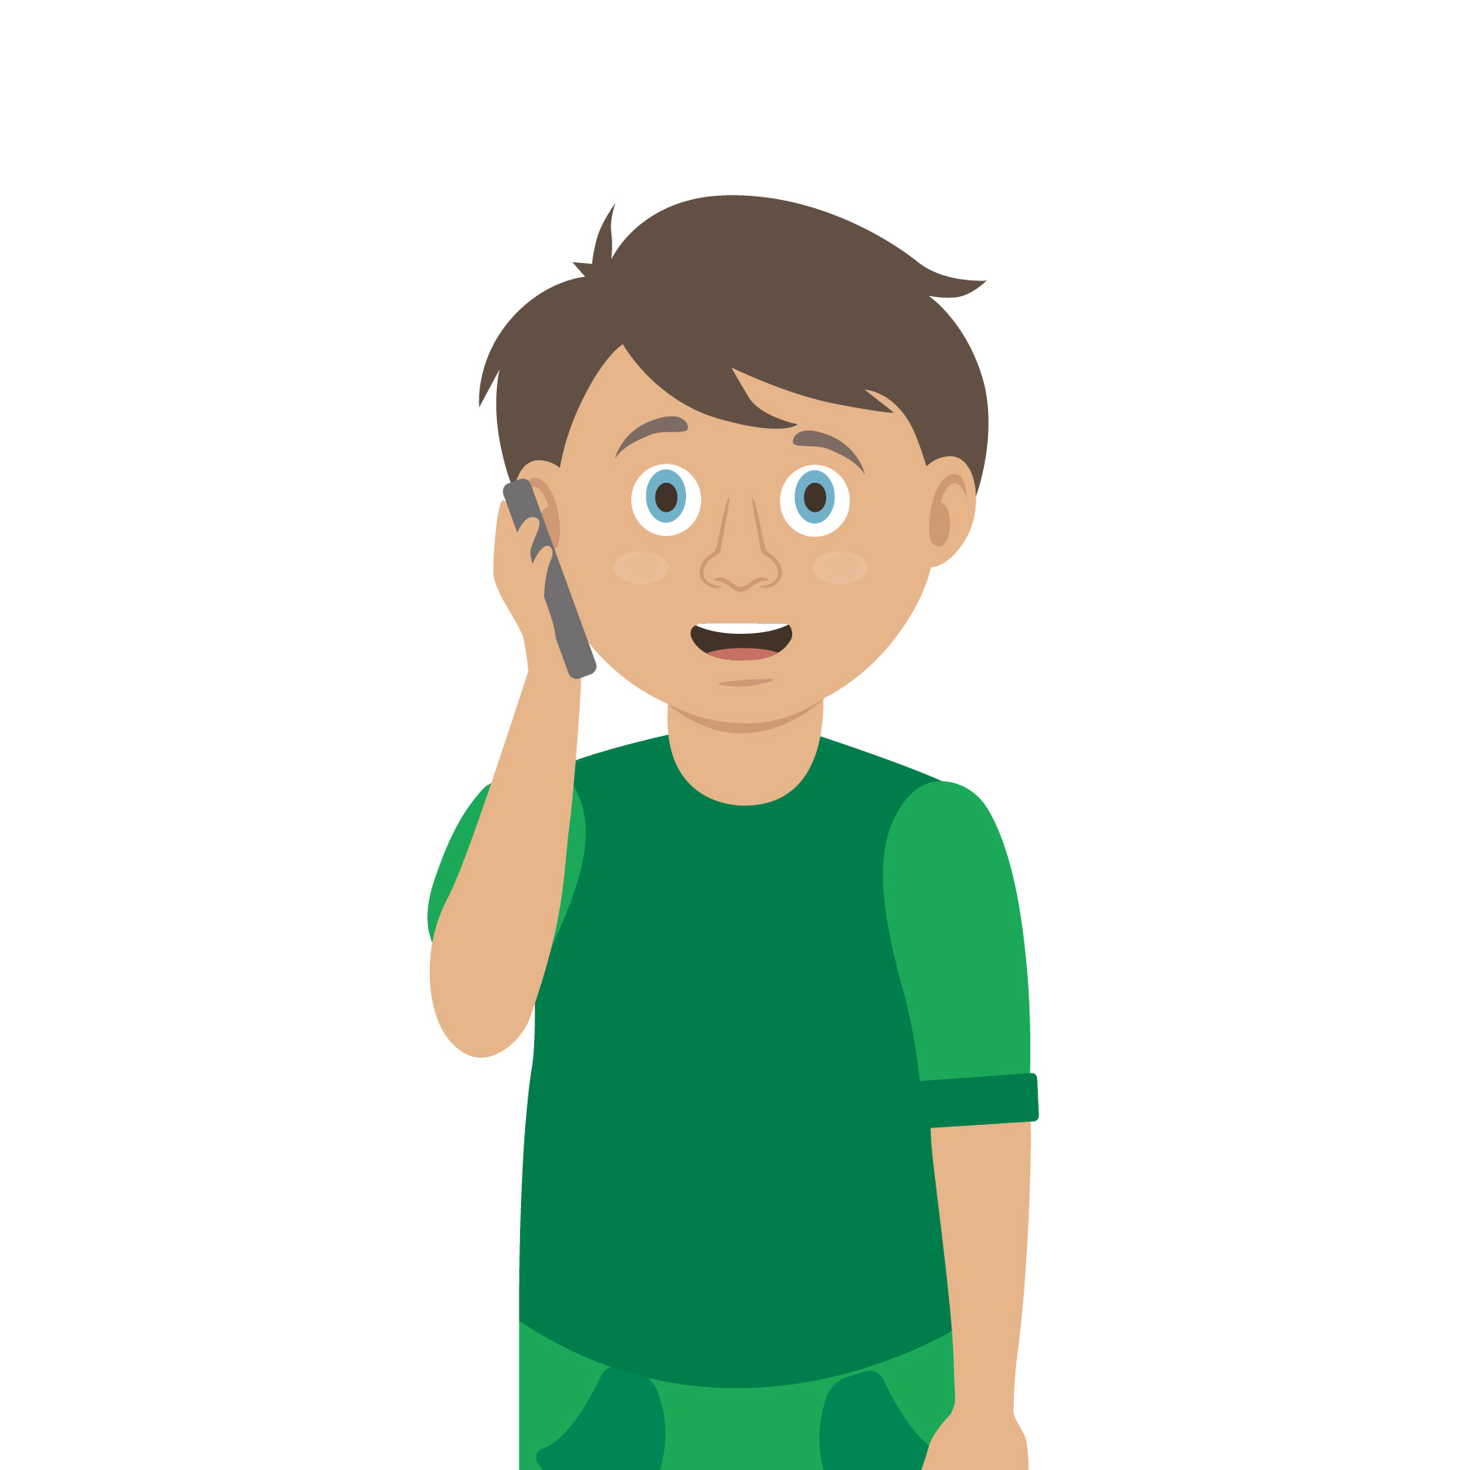
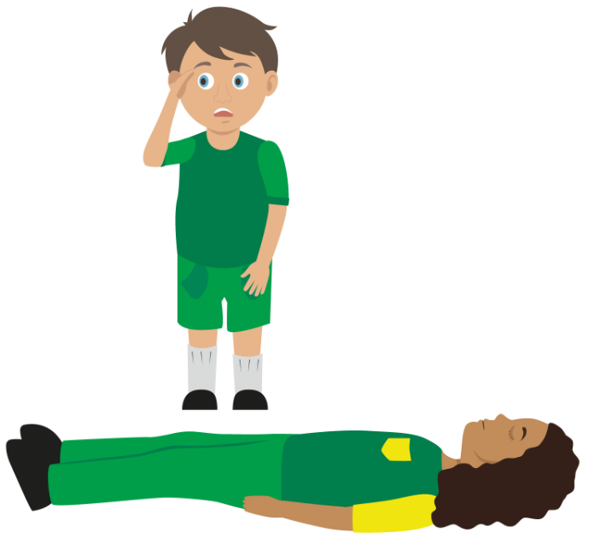
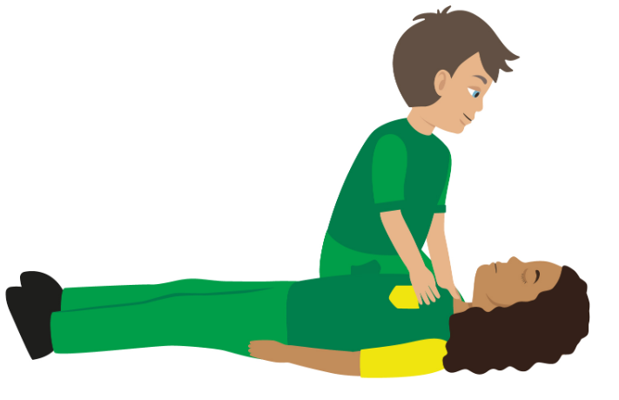
Your turn: Calling for help
Check for danger
Always make sure the area is safe
Call 999/111
If it is an emergency, call 999 or 112. Remember LIONEL to give them important details
Reassure casualty
Keep the casualty reassured
Stay with them until help arrives
If you have been taught any first aid which may be useful, then use it

