Slide 1
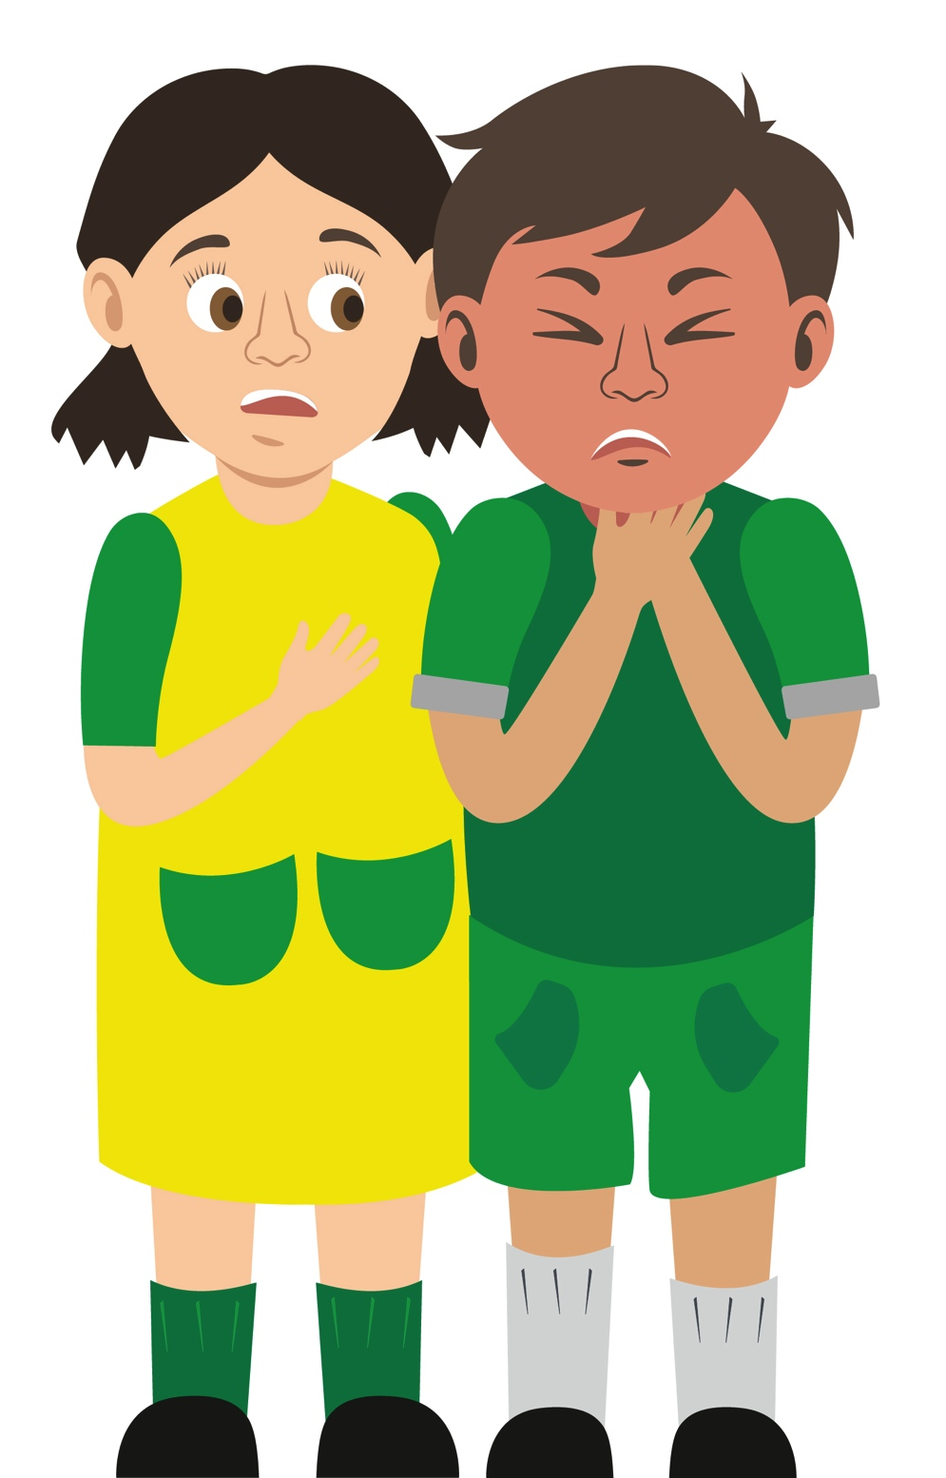
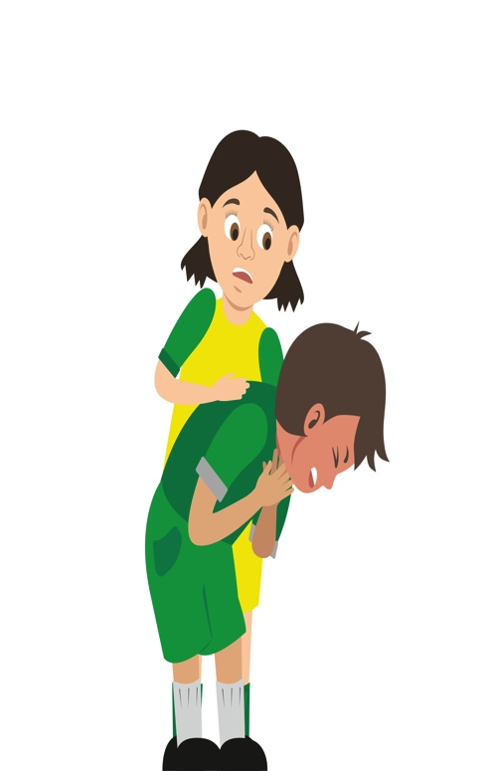
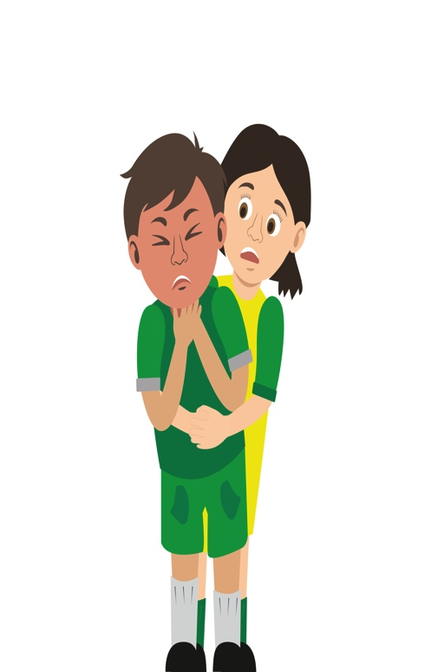

Your turn: Choking
1. Ask
‘Are you choking?’
2. Encourage
casualty to cough
3. Give
up to 5 back blows using the heel of your hand between their shoulder blades
4. Give
up to 5 ‘tummy’ thrusts (abdominal thrusts)
5. Help
if still choking call 999/112 for emergency help
Repeat the cycle if necessary
remember: your casualty could become unresponsive. Be prepared to perform CPR

