Slide 1
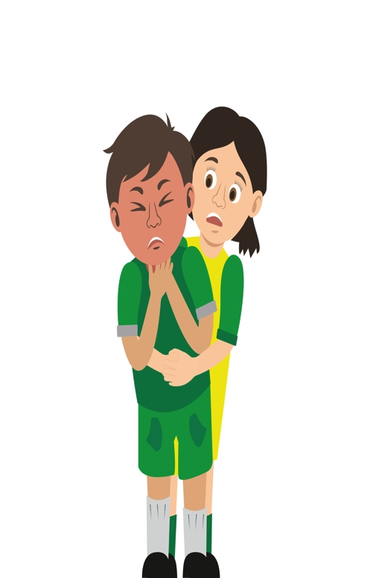
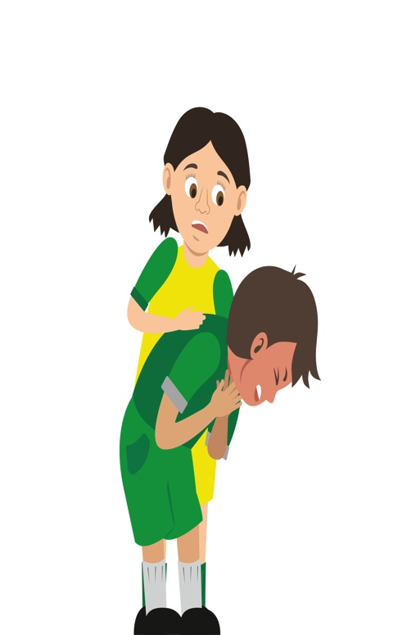
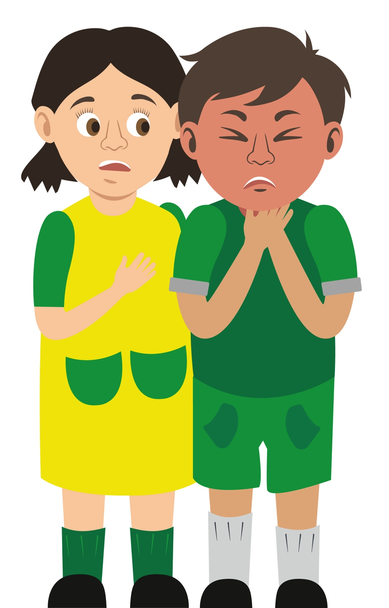
Starter Activity
Choking
Use your current first aid knowledge to explain what you could do for each of the 6 steps.
Step 1.
Step 2.
Step 3.
Number the images to show which step they belong to
Step 4.
Step 5.
Step 6.

Slide 2
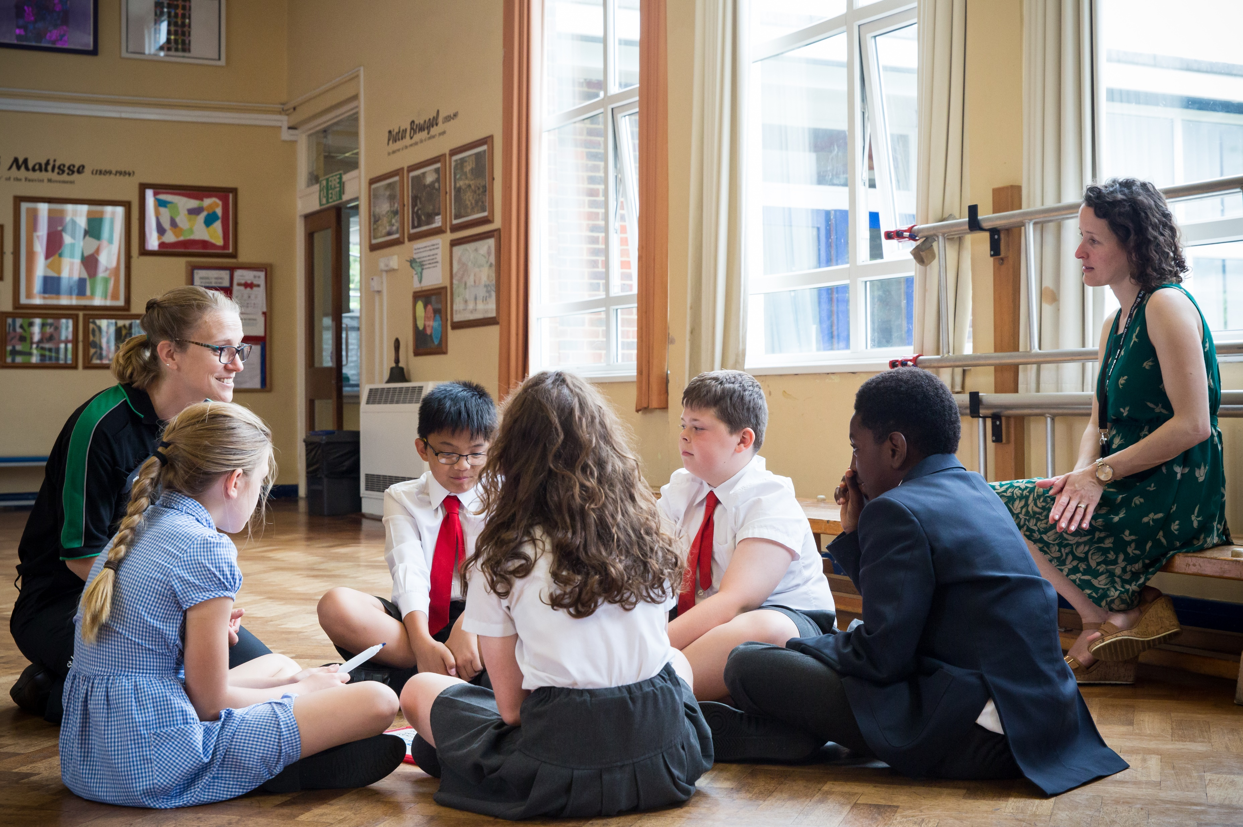


Choking
KS2 – Choking

Slide 3
Choking
A short course to learn how to help someone who is choking.

Slide 4
Learning outcomes
I can identify a casualty who is choking
I can assess and give first aid to a casualty who is choking
I can seek medical help if required
Notes:
Teacher should refer to ground rules for the session at this stage

Slide 5

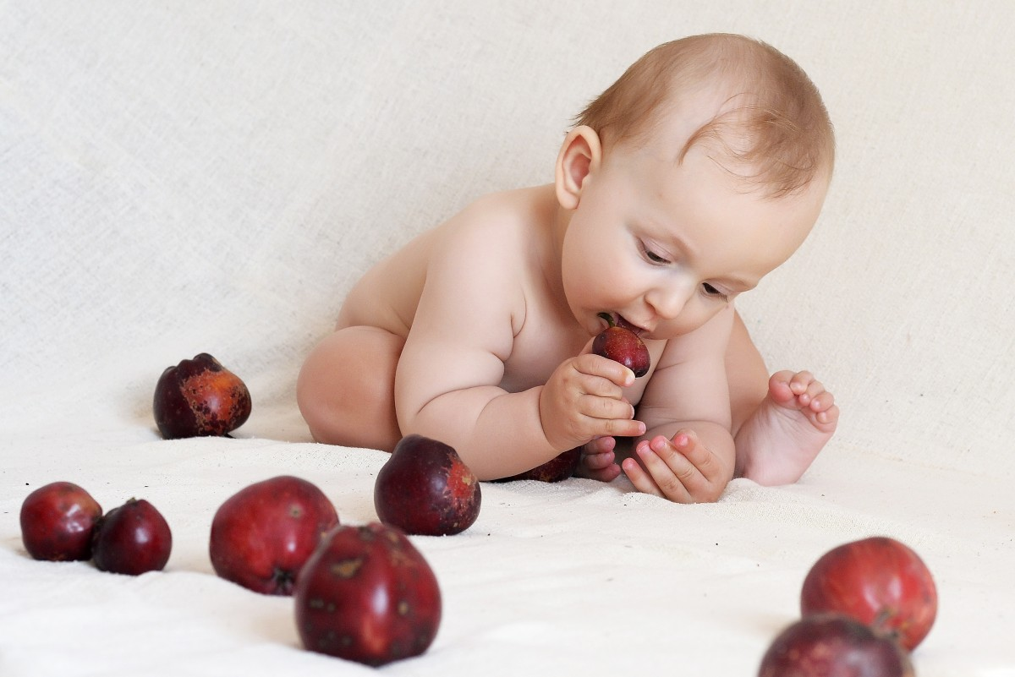
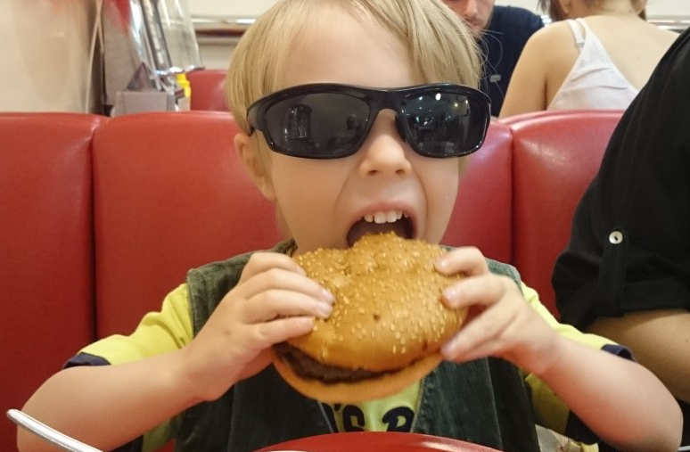
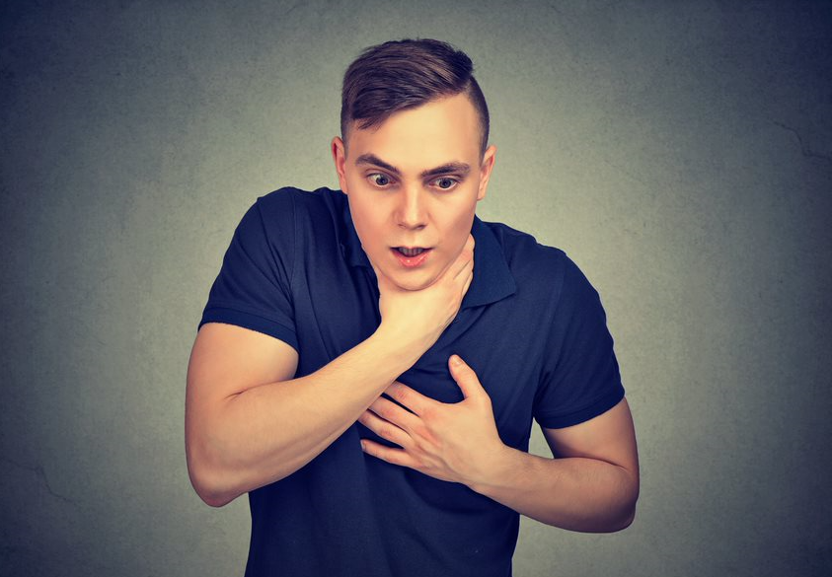
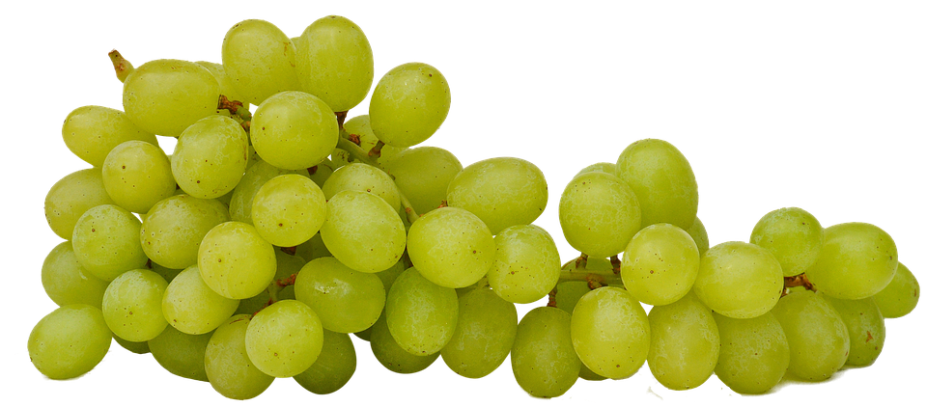
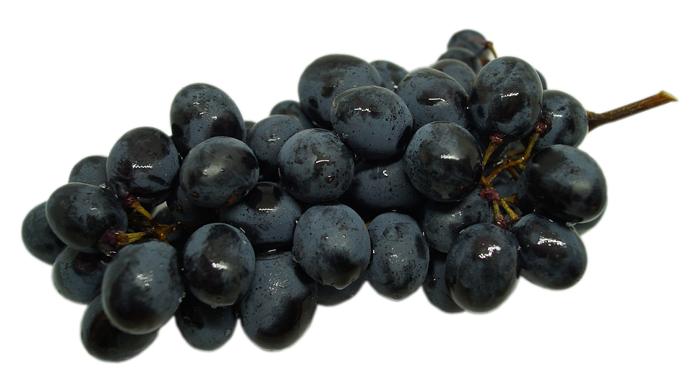
What do you see?
Notes:
Discuss - Safety, what could happen? What precautions could you take to try prevent choking occurring?
Pic 1 - Toddler eating (these should be cut in half lengthways)
Pic 2 Child eating a large burger (a big bite of bread can become stuck in throat and difficult to dislodge)
Pic 3 Adult with something in throat, if not able to cough or dislodge this can be potentially dangerous.
Who is most at risk in these pictures and why? – debate.

Slide 6


Choking
Tasks:
Name 3 things that you think are a choking hazard for toddlers
Name 3 things that you think are a choking hazard for your age group
Name 3 things that you think are a choking hazard for adults
Notes:
Discuss - babies airways are narrower and babies tend to put things in mouth that they can choke on i.e. toys, household objects on the floor, small foods (how do we prevent this and keep them safe?)
KS2 age group hazards are too much in mouth, talking whilst eating and running with food in mouth.
Adults (especially elderly) false teeth, rushing, talking, not chewing food properly.
Discussion prevention. Consider research of top hazards and comparing to previous answers.

Slide 7
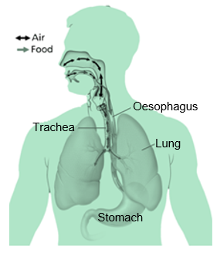
Choking
Basic anatomy
We put the food we eat into our mouth, chew it and swallow. It then travels down our body in to our S_ _ _ _ _ _.
We breathe air in through our mouth (and N_ _ _), this travels down a tube in our neck and into our lungs.
At the back of the throat, there is a flap with the job of ensuring that food and air go to the correct places.
Sometimes the flap doesn’t work fast enough and the airway can become B_ _ _ _ _ _.
Notes:
Stomach
Nose
Blocked
Emphasis on the “Flap” that separates the two paths. Air travels down a “tube” called the TRACHEA. Food travels down a “tube” called the OESOPHAGUS. Once entered the mouth food and air are separated and travel to their own destination.

Slide 8
Activity A24
Digestion of food
Students now have the opportunity to demonstrate their knowledge regarding the digestive process. Use our downloadable worksheet A24, which can be found on the St John Ambulance website.
Notes:
Optional activity

Slide 9

Choking A22
A SIGN is something you can see.
Signs and symptoms of someone who is choking could be…
A SYMPTOM is something that the casualty can feel.
Notes:
Write answers onto white board ready for next slide to compare.

Slide 10
Answers A22
Signs and symptoms of someone who is choking could be:
They may be unable to speak, breathe or cough
The casualty's face or neck may become very red or look a purple or blue colour
The may point to or grasp at their mouth or throat
They may stand up and look very distressed
They may look frightened with wide eyes
They may become unresponsive
Question:
How could you tell someone you were choking if you could not speak?
Explain your answer.

Slide 11
Watch this video
https://youtu.be/7G9PuAwoowI
KS2 – Choking

Slide 12
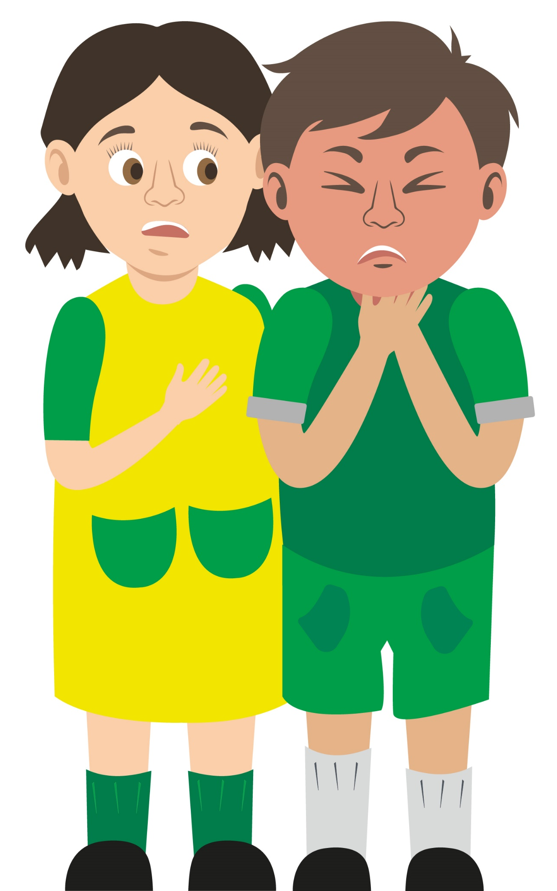
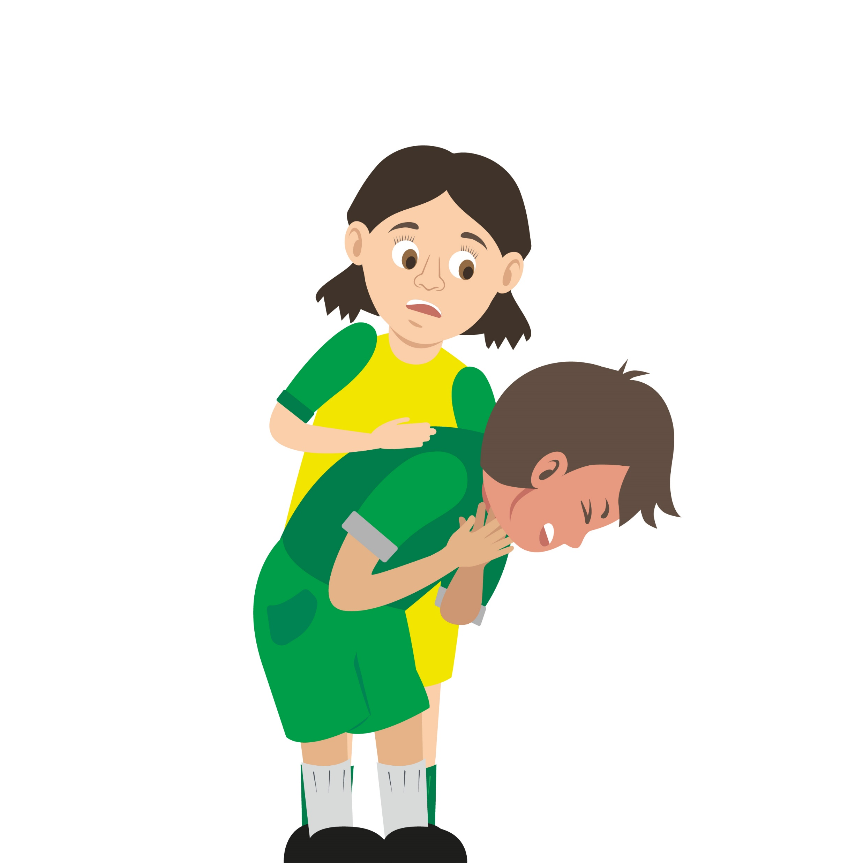
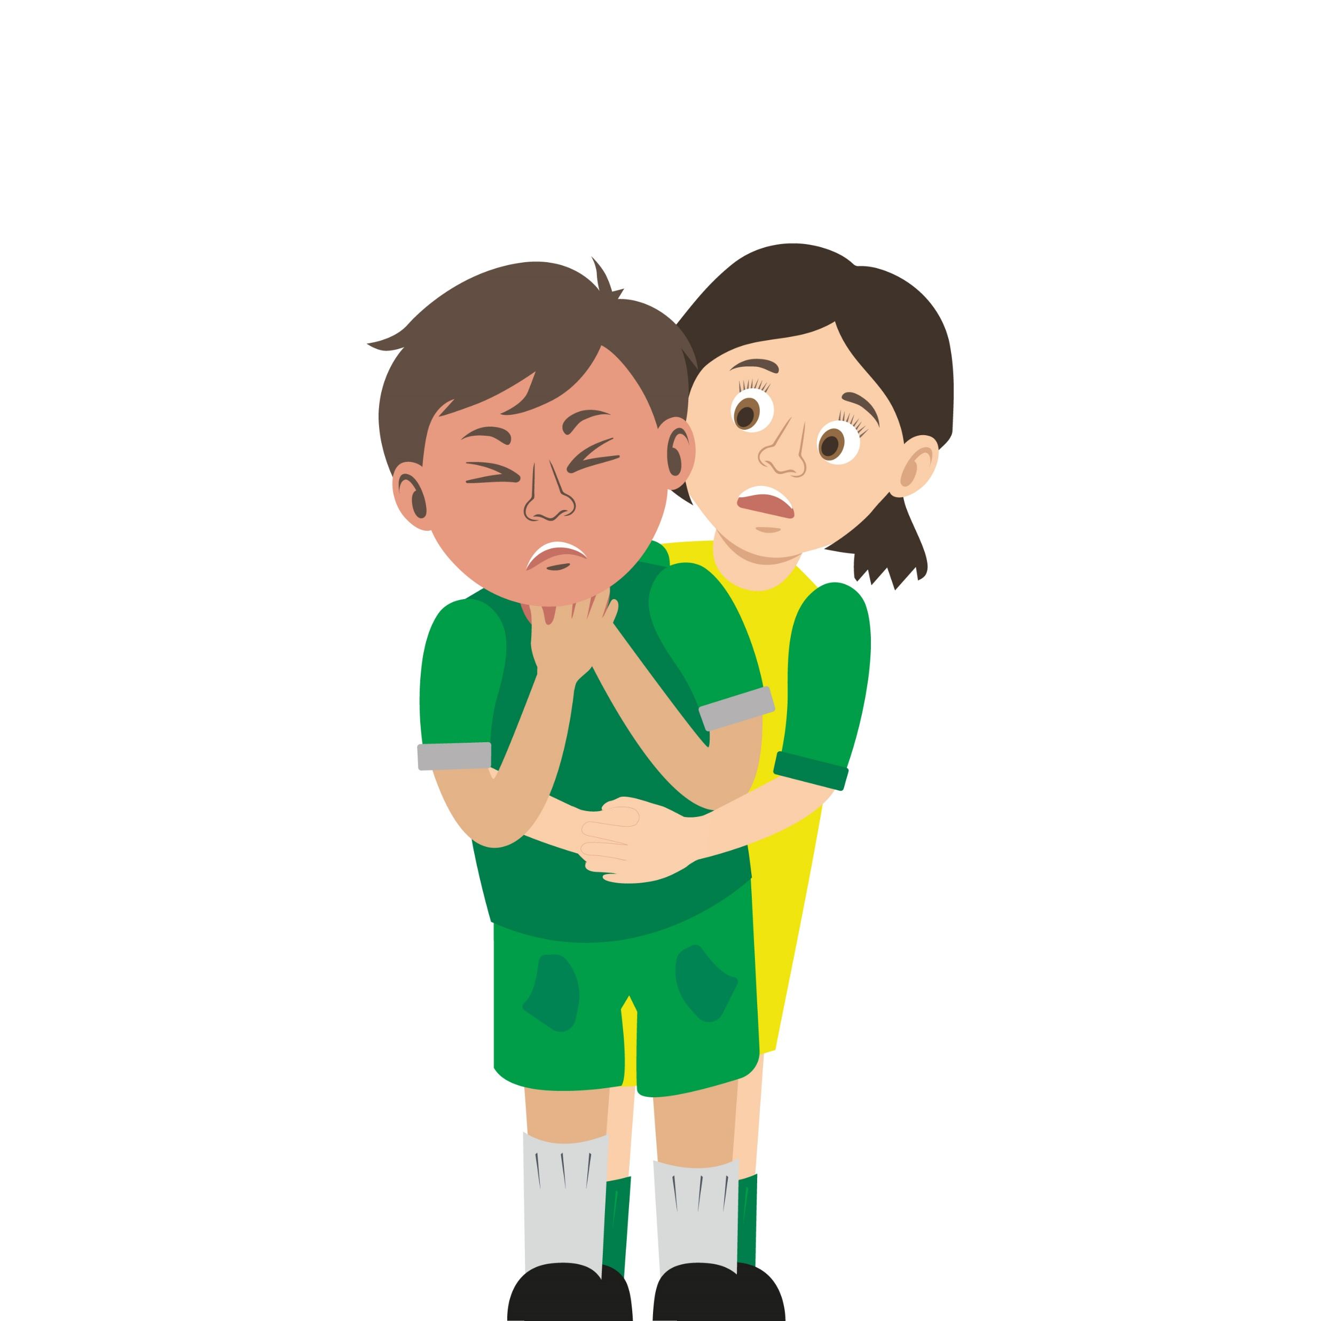

Your turn:
Choking
Ask the casualty if they are choking
Encourage them to cough
Give up to 5 back blows using the heel of your hand between the shoulder blades
Give up to 5 ‘tummy’ thrusts (abdominal thrusts)
If this is not successful call 999 or 112 for emergency help
6. Repeat if necessary
Do not forget to call for help.
REMEMBER that your casualty could become unresponsive. Be prepared to perform CPR.
KS2 - Choking
Notes:
Scenario cards are available which the teacher can use to make the practical activity relevant in a certain context for students.
In pairs/ small group demo management of a choking casualty

Slide 13
Activity
Recap quiz
In pairs stand up and take it in turns to do the following:
Show the part of your hand that you would use to give a back blow
Point to where on your partners back you would give a back blow
Show where you would press to do an abdominal thrust (tummy thrust).
Notes:
Answer = 1. heel of hand. 2. between shoulder blades. 3. between tummy button and rib cage.

Slide 14
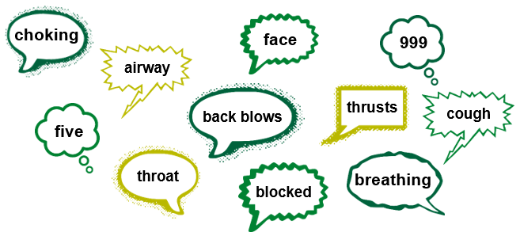
Activity A25 extensions
Choking word checklist
This activity allows students to demonstrate their learning on how to deal with a casualty who is choking. Use the words below to create a checklist to assist a casualty who is choking.

Slide 15
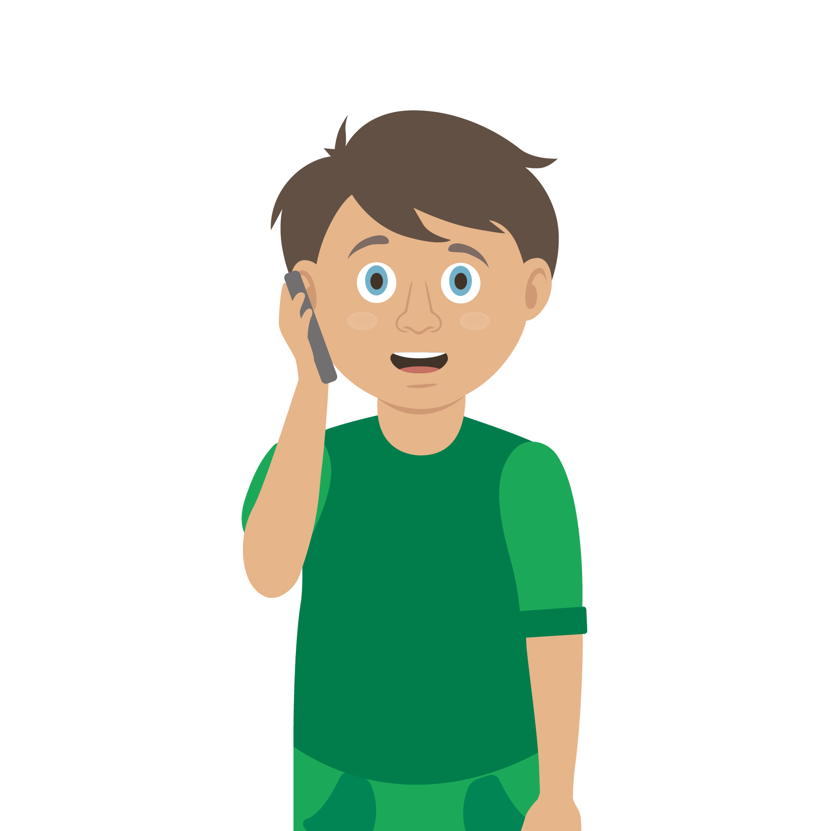
Casualty care
Pause for thought...
Which actions do you think are most important when caring for a casualty?
Get help
No food or drink
Prevent condition worsening
Remain calm
Keep warm
Treat with dignity and respect
Reassure casualty
Communicate well
Notes:
Opportunity to discuss common casualty care skills which are necessary in all first aid situations.

Slide 16


Check your learning
I am able to:
Identify when someone is choking
Give first aid to a casualty who is choking
Call for help correctly, if it is necessary
YES NO
|

Slide 17

Information and support
If any of the content in this session has upset or concerned you please discuss this with one of the teachers at your school
Further support can be found at:
www.childline.org.uk
www.youngminds.org.uk
www.samaritans.org
Further information linked to first aid can be found at:
www.sja.org.uk
www.asthma.org.uk

Slide 18

Thank you!

Slide 19
Choking A22
A SIGN is something you can see.
Signs and symptoms of someone who is choking could be…
A SYMPTOM is something that the casualty can feel.
Notes:
Write answers onto white board ready for next slide to compare.

Slide 20
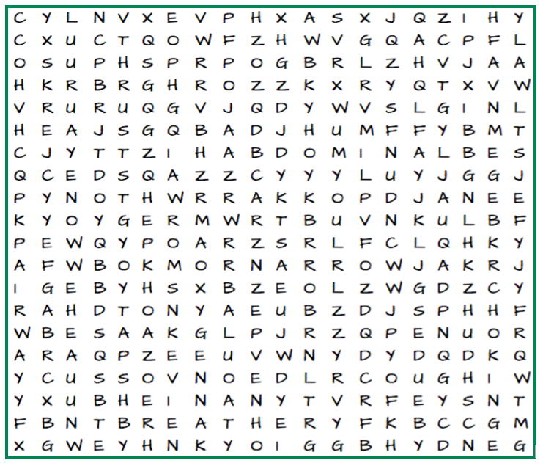
Activity A23
Word search
This activity allows students to find topic key words from the word search. Download activity sheet ‘optional activity – word search’ from the St John Ambulance website.

Slide 21
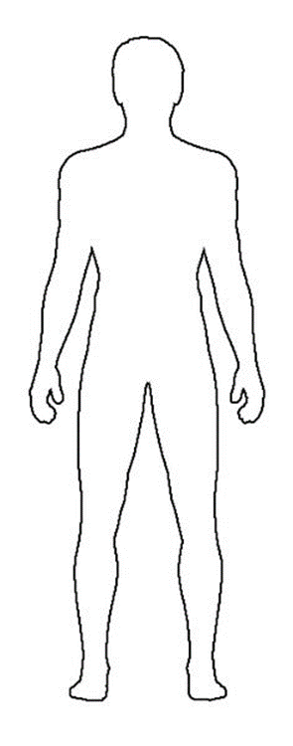
Activity A24
Digestion
This activity allows students to demonstrate their knowledge of the digestive system. Download activity sheet ‘A24 digestion’ from the St John Ambulance website.
When we are eating, we move and taste food with our tongue, we use our teeth to chew food into pieces that are small enough to swallow.
When this food is swallowed it travels into the oesophagus, this is a long tube that carries foods into the stomach.
As food moves through the stomach it enters the small intestine, it then breaks down into pieces tiny enough to feed the cells in your body.
Any pieces of food that the cells in your body do not need keep moving through the large intestine, this waste then leaves the body at the rectum. This whole process is known as digestion.

Slide 22
Activity A25 extensions
Choking word Checklist
This activity allows students to demonstrate their learning on how to deal with a casualty who is choking. Use the words below to create a checklist to assist a casualty who is choking.

