Slide 1
Starter Activity
Severe Bleeding
Number the images to show which step they belong to
Use your current first aid knowledge to explain what you could do for each of the 5 steps below.
Step 1.
Step 2.
Step 3.
Step 4.
Step 5.

Slide 2
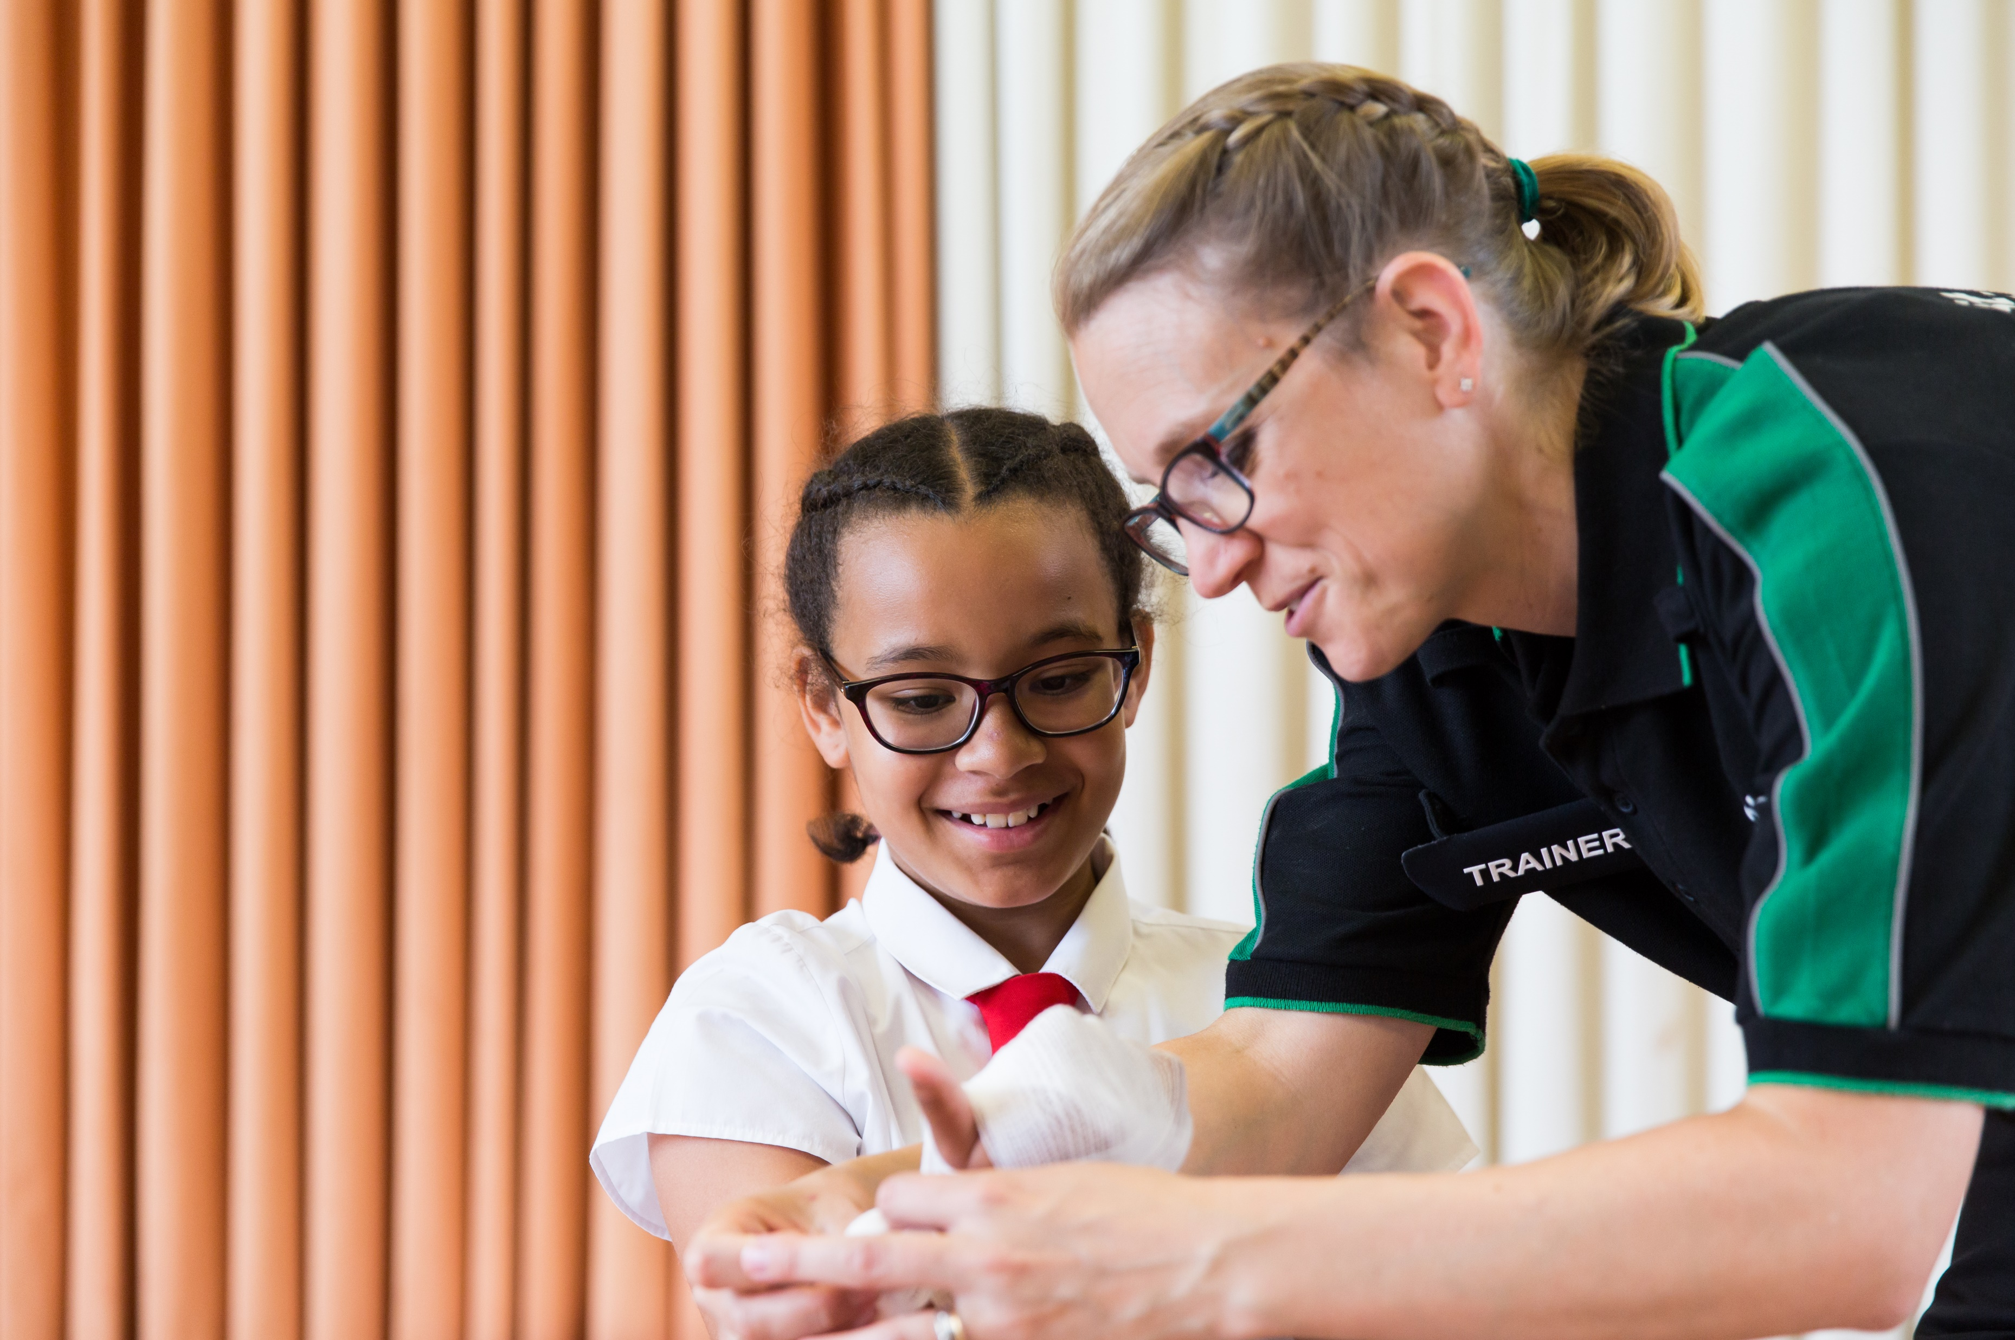


Bleeding

Slide 3

Bleeding
A short course to learn how to help someone who is bleeding.

Slide 4
Learning outcomes
I can ensure the safety of myself and others
I can assess a casualty’s condition calmly and give first aid to someone who is bleeding
I can give first aid to a casualty who is in shock
I can seek medical help if required for a casualty who is bleeding
Notes:
Teacher should refer to ground rules for the session at this stage

Slide 5
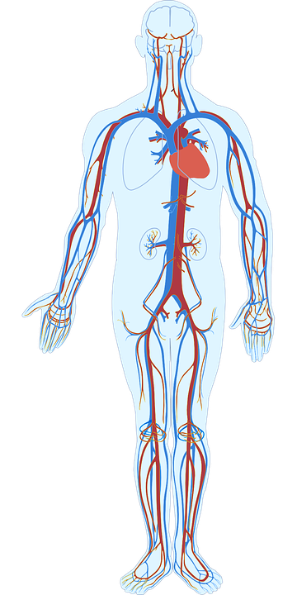
Blood
Basic anatomy
Blood is made up of different things and travels around inside of our body. It provides the body with a lot of important things we need to survive.
The H_ _ _ _ pumps blood around the body.
Blood travels around the body inside of vessels which are all different sizes.
Notes:
A: Heart
Optional activity A5 lLets make blood can link here

Slide 6



What do you see?
Notes:
To note is the colour of the blood flow.
Red arrow shows flow of blood that is rich in oxygen travelling FROM the heart.
Blue arrow shows the path of blood that is travelling back to the lungs to be re oxygenated.
It is a closed complex system. Any interruption to this (e.g. blood loss - injury) causes issues as organs may not then receive the oxygen they need to survive and keep our body functioning as it should.

Slide 7

What do you think?
A SIGN is something you can see.
Signs and symptoms of someone bleeding could be…
A SYMPTOM is something that the casualty can tell you they are feeling.
Notes:
Write answers onto white board ready for next slide to compare.

Slide 8
Answers
Signs and symptoms of someone bleeding from an injury could be:
Pain and blood at site of the injury
Pale skin
Feeling faint
Rapid pulse or heart rate
Distress and anxiety
Bruising and swelling
Lack of response
Question:
Would you call for help if you found someone with these signs and symptoms?
Explain your answer.

Slide 9
Watch this video (warning footage contains scenes of bleeding)
https://youtu.be/kRrkE8A4ceI
KS2 – Bleeding
Notes:
PLEASE CHECK******STUDENTS DO NOT MIND THE SIGHT OF BLOOD*******before playing this video

Slide 10
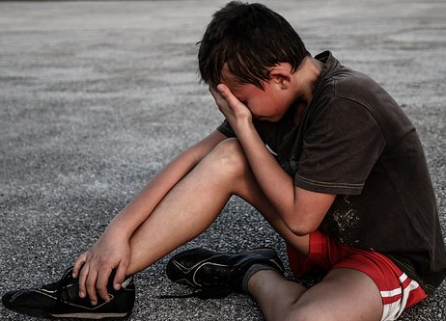

Activity A10
Group work
Discuss in pairs
Describe how it might feel if someone was injured and bleeding
QUESTION:
What should you do straight away if you found someone who is bleeding?
QUESTION:
What could you wear (if it is possible) when dealing with someone who is bleeding? Why
Notes:
Answers to point 2 on the next page -

Slide 11

Activity A10
Answers
Reassure
Positioning
Call for help
Pressure
Be alert for shock
Immobilise
Notes:
Check answers to confirm learning from video and session content
Key learning points are reassure, immobilise, pressure, be alert for shock, positioning and call for help.

Slide 12
Shock
What is shock?
Shock is a life-threatening medical condition which is caused by a lack of blood supply to the major organs in the body.
Lack of blood supply causes a lack of oxygen supply to the major organs. By recognising and treating shock quickly you can help keep the major organs working.
Signs and symptoms of someone in shock could be:
Rapid, shallow breathing
Cold, clammy skin
Rapid, weak pulse
Dizziness or fainting
Weakness
Sweating
Restlessness

Slide 13

Your turn: Severe bleeding
1. Put on gloves
2. Apply pressure to the wound
(but only if there is nothing stuck in it)
3. Apply a dressing to the wound
the pad goes over the injury
use bandage to secure it in place
make sure the bandage is not too tight
call 999/112
4. Apply second dressing, if needed
no more than two dressings at a time
5. If an object is in the wound, do NOT remove it
put a pad on either side of the object
bandage carefully over the pads without pushing the object in any further
KS2 - Bleeding
Notes:
Scenario cards are available which the teacher can use to make the practical activity relevant in a certain context for students.

Slide 14
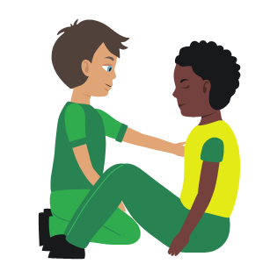
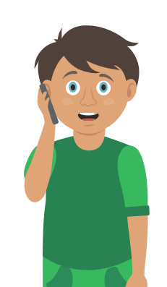
Your turn: Nosebleed
1. Sit
the casualty down leaning forward
2. Ask
them to pinch the soft part of their nose for 10 minutes
3. Check
if the bleeding has stopped
if still bleeding pinch nose for a further 10 minutes
4. Re-check
if still bleeding pinch for a further 10 minutes
5. Help
if bleeding has not stopped after a maximum of 30 minutes seek medical help
KS2 - Bleeding
Notes:
Scenario cards are available which the teacher can use to make the practical activity relevant in a certain context for students.

Slide 15
Your turn: Dealing with shock
1 Treat
any injuries that may have caused shock
2 Help
the casualty to sit down, then lie down
3 Raise
and support the casualty’s legs if possible
4 Call
999/112
5 Reassure
them and loosen any tight clothing
6 Keep
the casualty warm
KS2 - Bleeding
Notes:
Scenario cards are available which the teacher can use to make the practical activity relevant in a certain context for students.

Slide 16
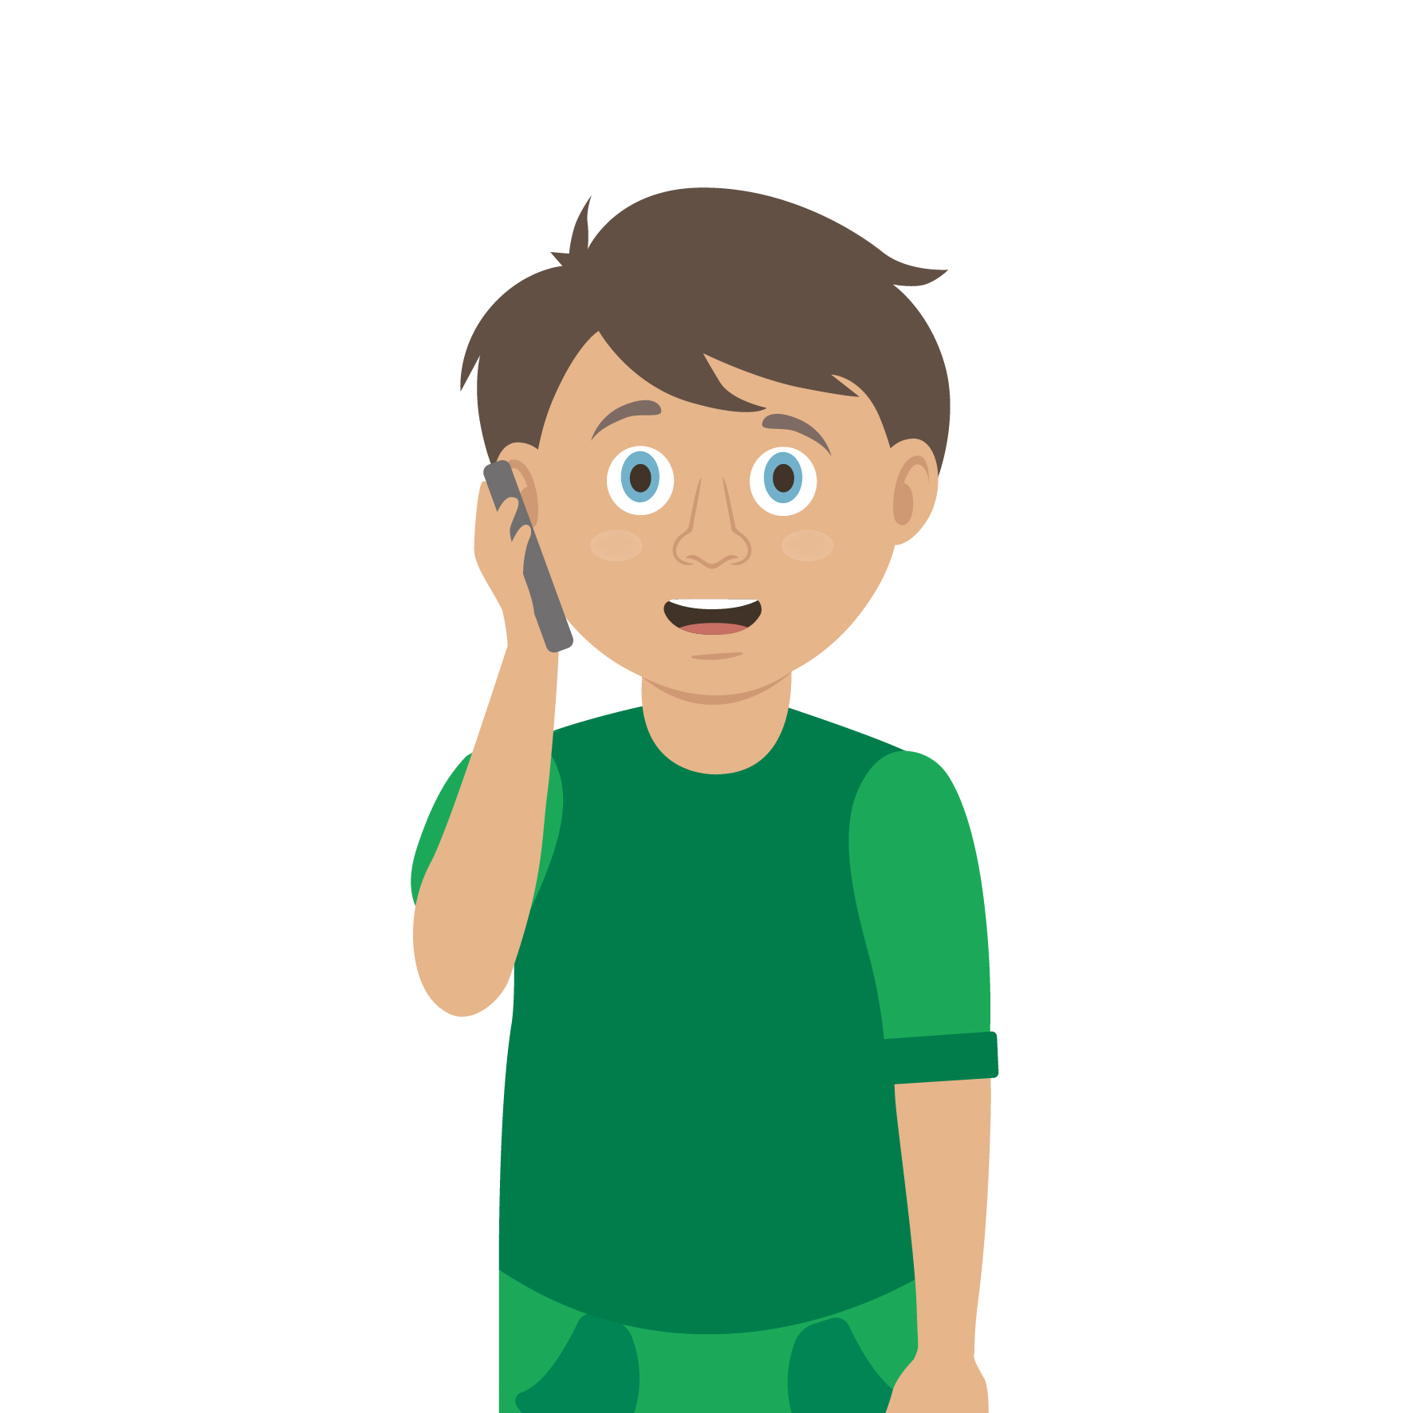
Casualty care
Pause for thought...
Which actions do you think are most important when caring for a casualty?
Get help
No food or drink
Prevent condition worsening
Remain calm
Keep warm
Treat with dignity and respect
Reassure casualty
Communicate well
Notes:
Opportunity to discuss common casualty care skills which are necessary in all first aid situations.

Slide 17


Check your learning
I am able to:
Identify when someone is bleeding
Give first aid to a casualty who is bleeding
Give first aid to a casualty who is in shock
Call for help correctly, if it is necessary
YES NO

Slide 18

Information and support
If any of the content in this session has upset or concerned you please discuss this with one of the teachers at your school
Further support can be found at:
www.childline.org.uk
www.youngminds.org.uk
www.samaritans.org
Further information linked to first aid can be found at:
www.sja.org.uk
www.asthma.org.uk

Slide 19

Thank you!

Slide 20
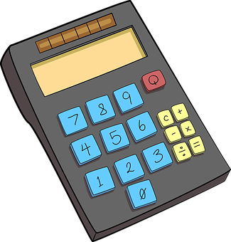
Optional activity A7
Blood
Use the worksheet to complete the pie chart and find out more about the contents of our blood.

Slide 21
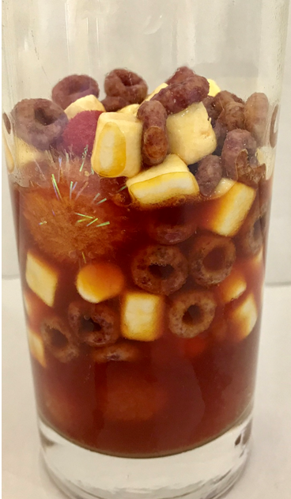
Optional activity A5
Making blood

Slide 22
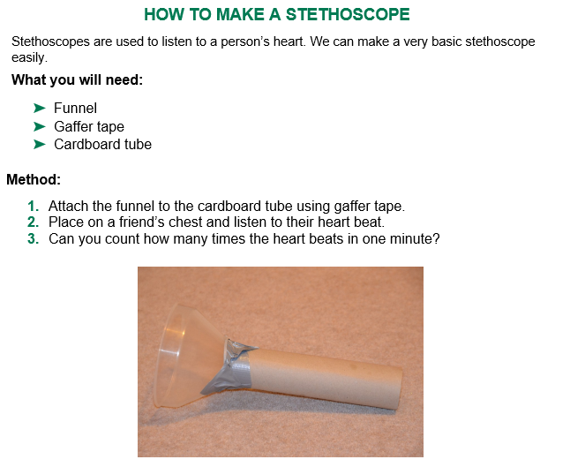
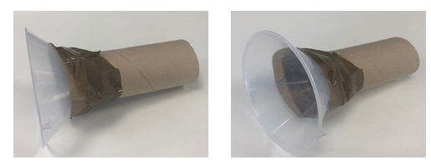
Optional activity A11
Make a stethoscope
Notes:
Activity - you can make a stethoscope and listen to your heart
what happens after a period of exercise?
Time this and record your findings

Slide 23
Watch this video
https://youtu.be/yydY4OAE9DU

