Slide 1
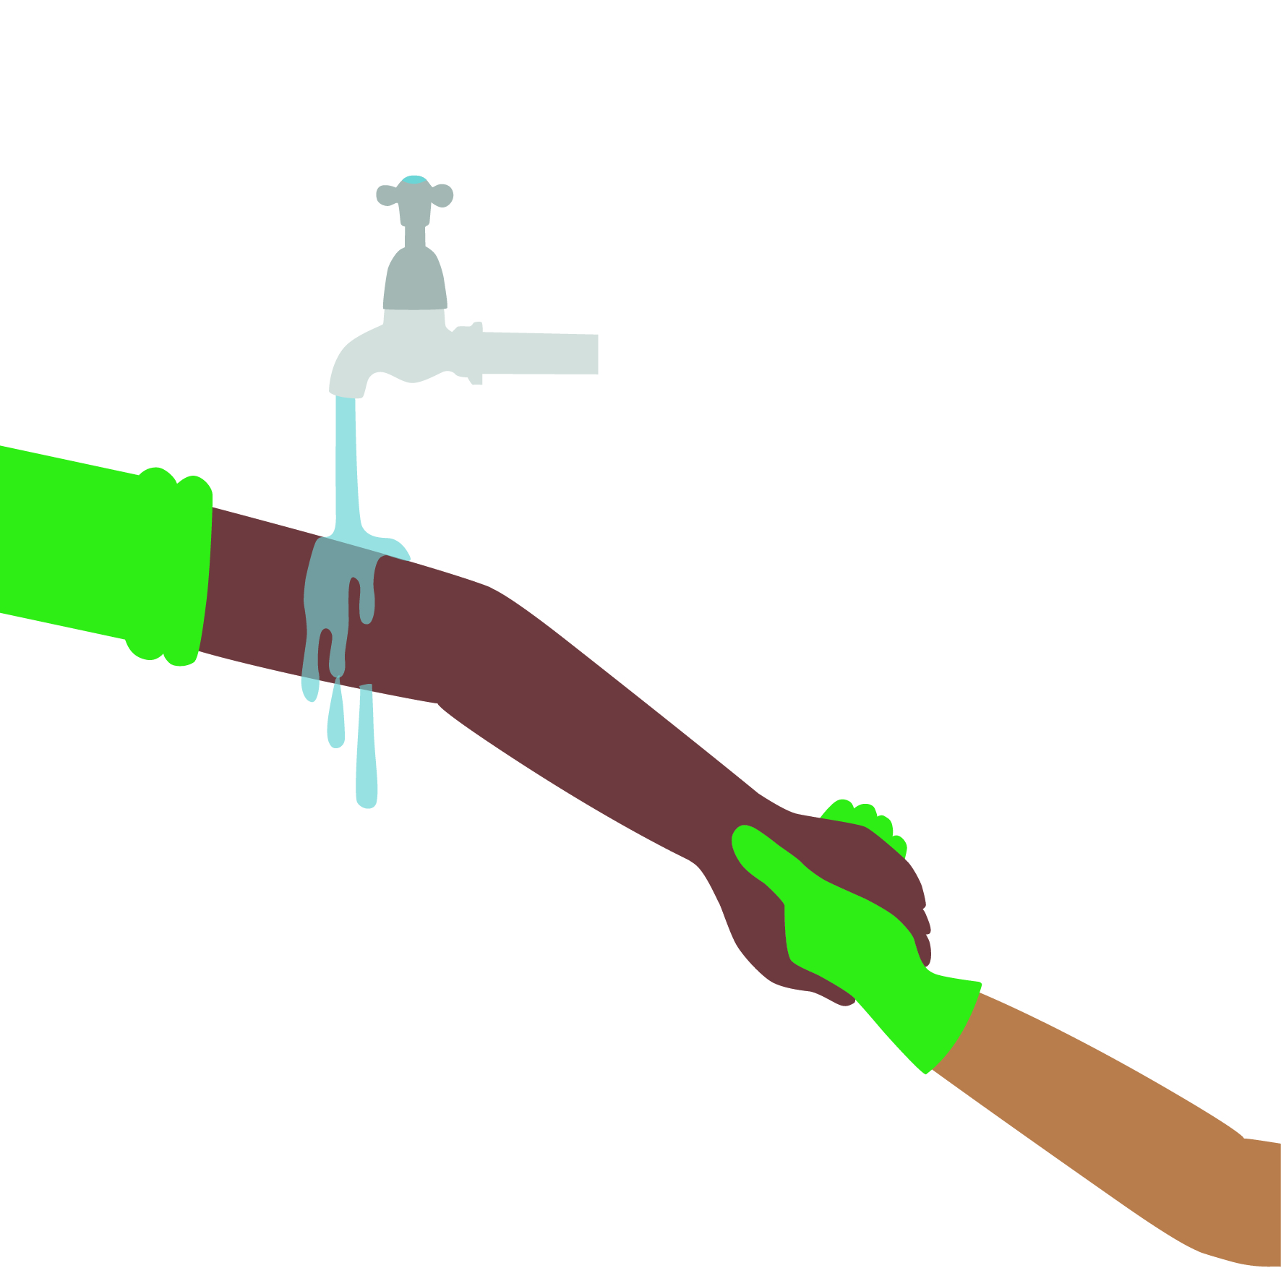
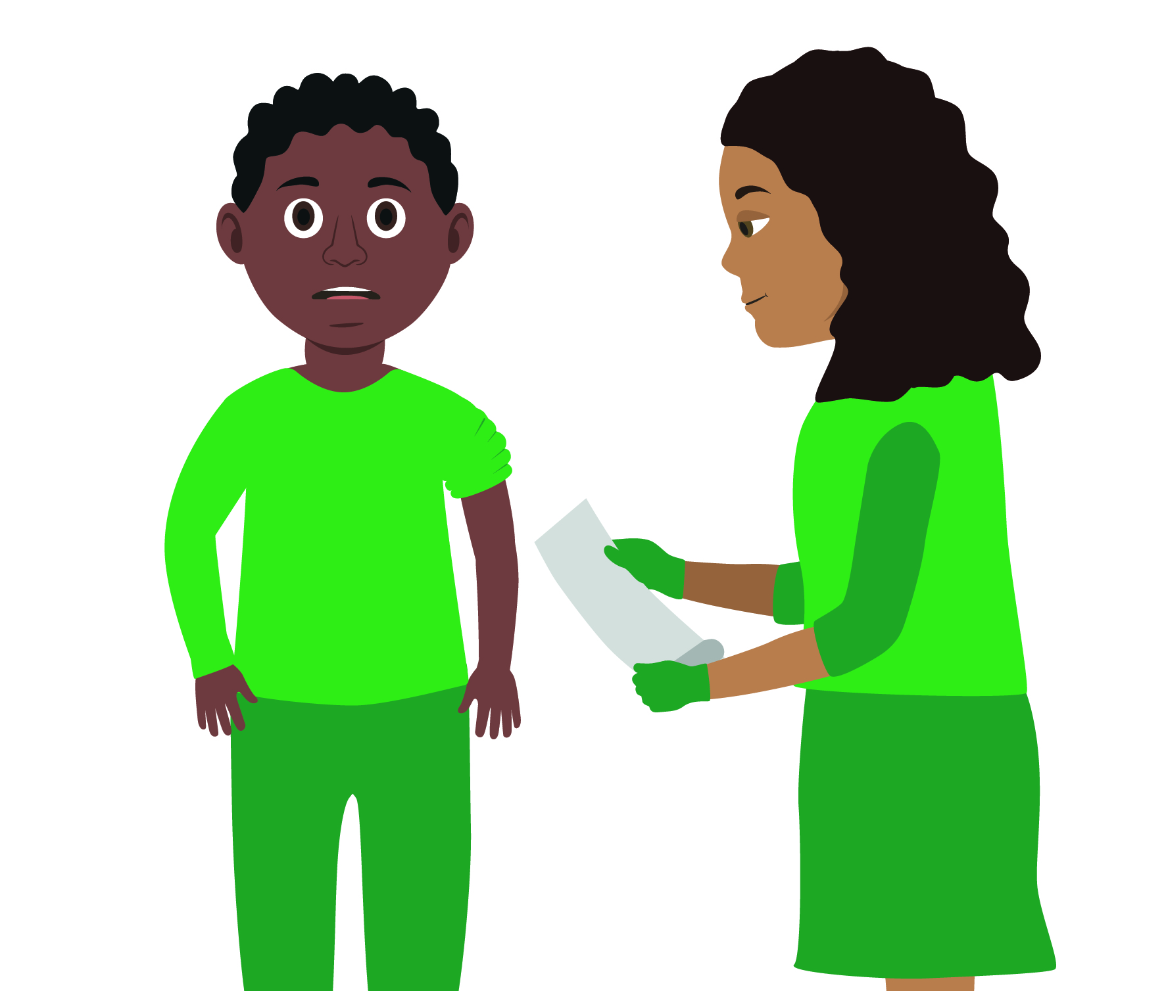
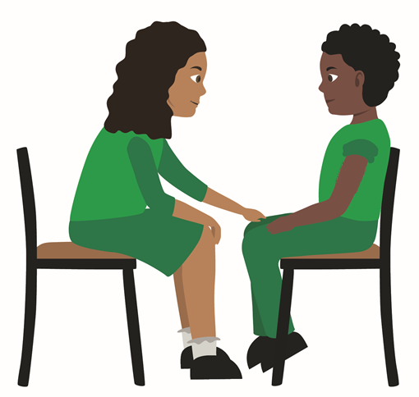
Starter Activity
Your turn:
Treating bites
Use your current first aid knowledge to explain what you could do for each of the 5 steps.
Number the images to show which step they belong to
Step 1.
Step 2.
Step 3.
Step 4.
Step 5.
Notes:
In pairs/ small group demo management of an animal/human bite

Slide 2
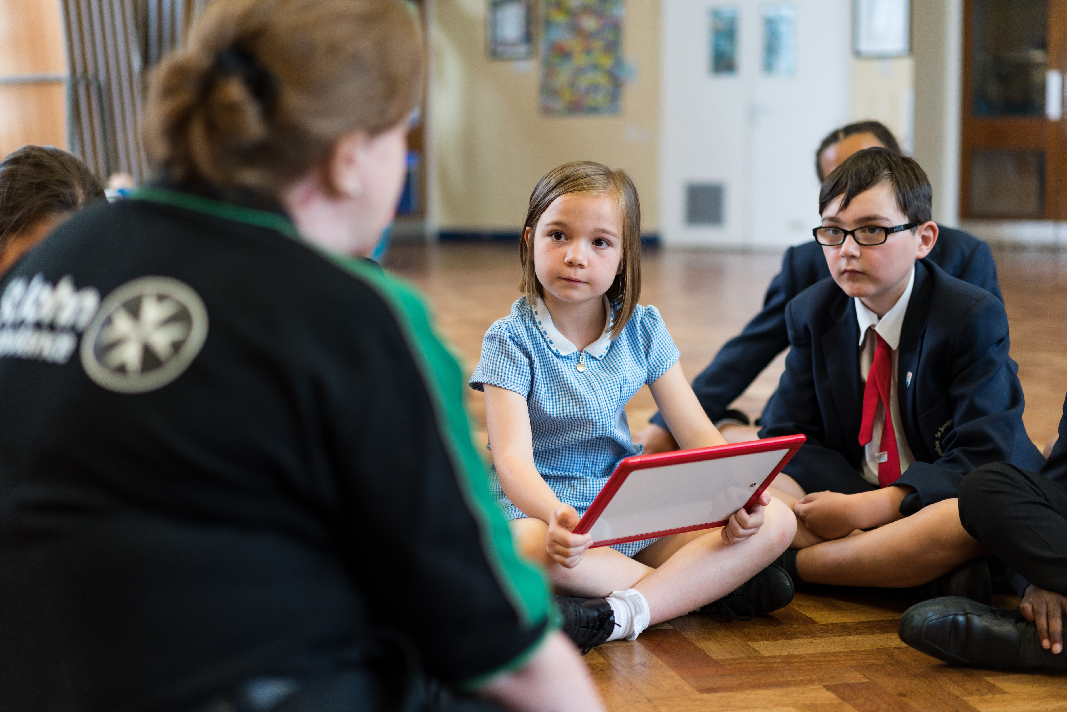


Bites and stings
KS2 – Bites and Stings

Slide 3

Bites and stings
A short course to learn how to help someone who has just been bitten or stung.

Slide 4
Learning outcomes
I can identify when a casualty is having an allergic reaction to a bite or sting
I can provide first aid treatment for a casualty who has been bitten or stung
I can comfort and reassure a casualty who has been bitten or stung
I can seek medical help if required
Notes:
Teacher should refer to ground rules for the session at this stage

Slide 5
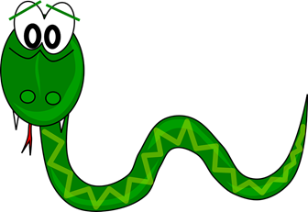
Bites
Bites or stings in the mouth or throat are potentially dangerous because swelling can obstruct the airway
Bites from some snakes, spiders and mosquitoes can cause serious illness, and may be fatal
Ticks are tiny creatures that attach to animals and humans to bite into the skin to suck blood, they carry disease, so should be removed as soon as possible
Be alert and watch for signs of an allergic reaction, which may lead the casualty to suffer anaphylactic shock

Slide 6
Stings
Stings are painful and can also be dangerous, scorpion and jellyfish stings can be fatal
An initial sharp pain is followed by swelling, redness and soreness, venomous creatures may produce a lot of pain and swelling
Multiple insect stings can produce a serious reaction
A sting in the mouth or throat is potentially dangerous because swelling can obstruct the airway
With any sting it is important to watch for signs of an allergic reaction, which can lead to anaphylactic shock

Slide 7
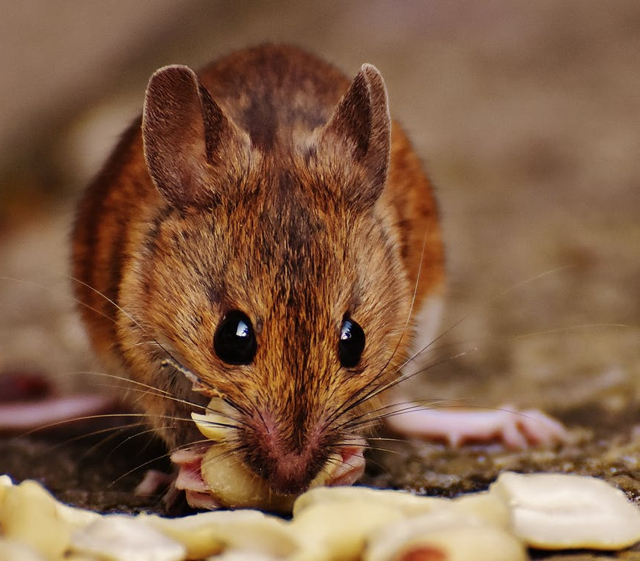
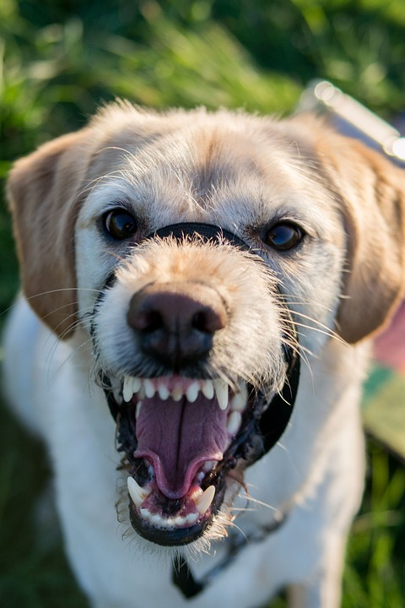
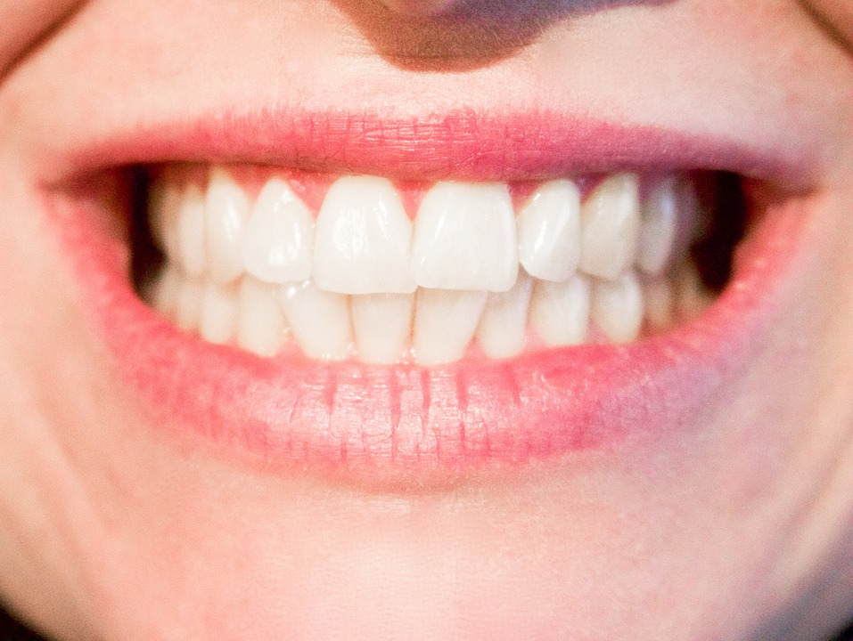
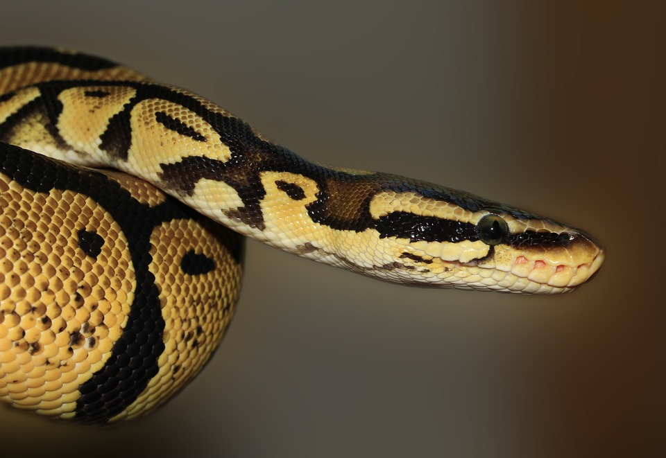
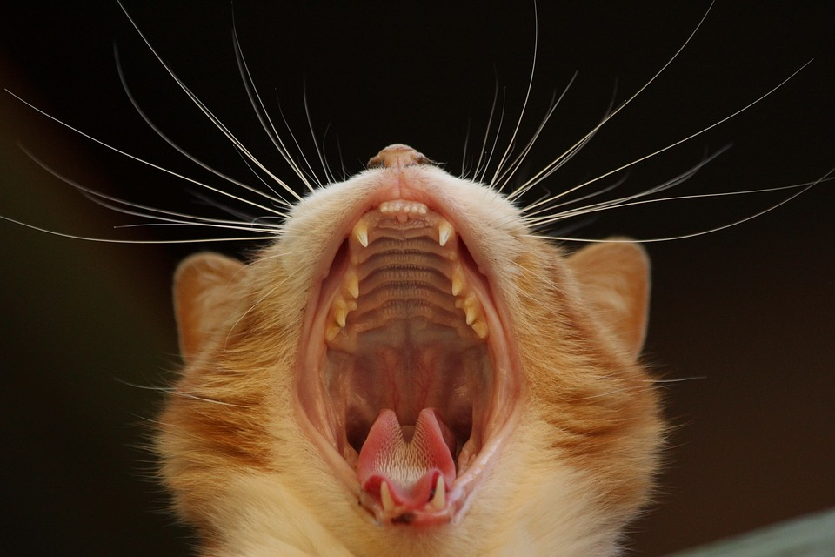
Bites A21
Question:
Name 5 things that could bite you
Question:
What sort of injury could you get from a bite? (consider the teeth in the pictures opposite to get an idea)
*See worksheet on slide 20
Notes:
Suggestions - Rodents, Dogs, Snakes, Cats, Humans
Look at images of teeth and discuss- Bites can crush and damage tissues of skin. small and sharp pointed teeth may cause puncture wounds easily. Larger sharp teeth may do serious harm by causing a large wound.
Size of mouth may have an impact on size of wound and a bite with venom (eg snake) could be fatal.

Slide 8
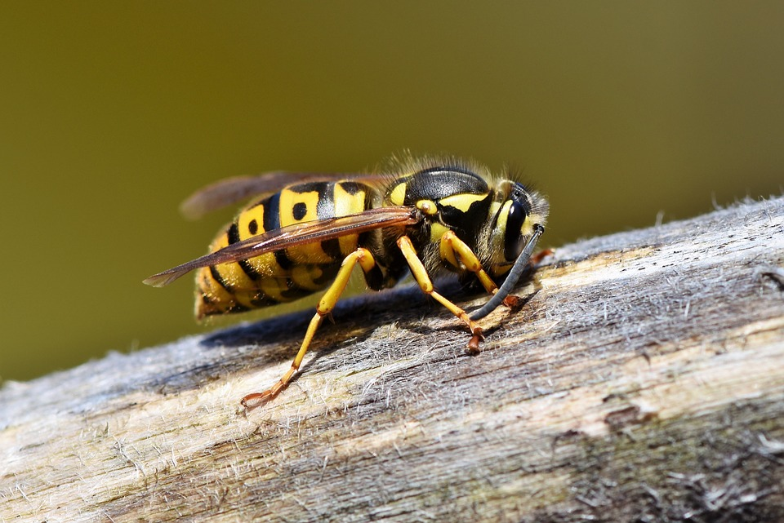
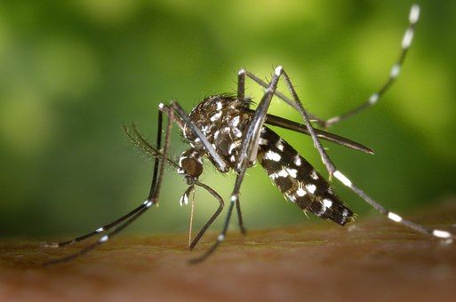
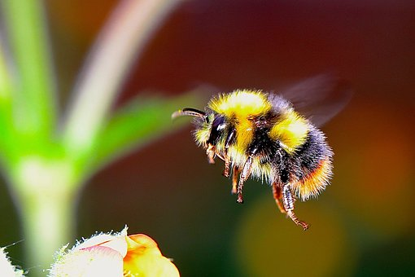
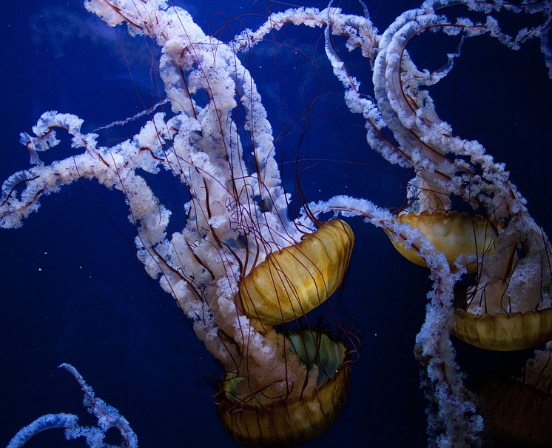
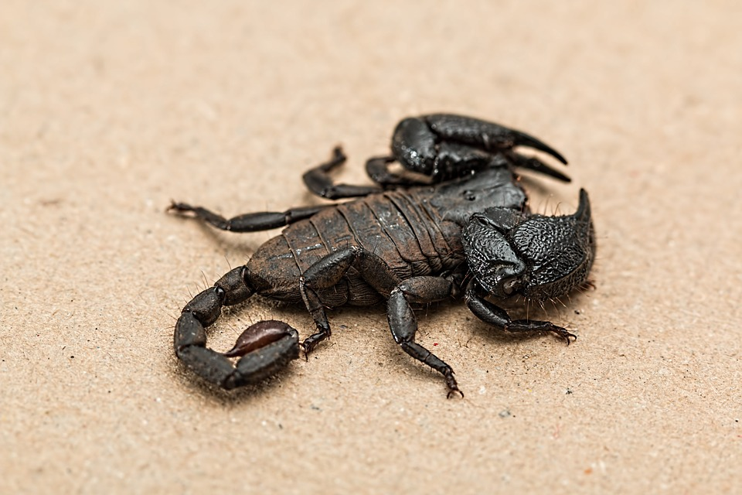
Stings
Answer and discuss the following:
Name 5 things that could sting you
Describe what it might feel like to be stung
What might it look like when you have been stung?
Notes:
Suggestions – Wasps, Mosquitos, Jellyfish, Scorpion, Bumblebee
Feel scared and upset, painful in the area - it may look red, swollen.

Slide 9
Bites and stings charades A20
You can now play a fun game with activity A20. This activity allows students to identify creatures that may bite or sting. To complete this use our downloadable worksheet found on the St John Ambulance website.

Slide 10

What can go wrong?
Allergic Reaction
An allergic reaction can occur from a bite or sting. This can be really dangerous for the casualty. It may cause problems with their airway and breathing.
If there are any other signs of a severe allergic reaction (anaphylaxis) you should seek urgent medical attention.
Infection
Bites from sharp teeth can cause deep puncture wounds that can damage tissues and put germs inside of the body.
Any bite that breaks the skin needs urgent medical attention.
Q: What are the signs of an allergic reaction?
Notes:
Signs of an allergic reaction are: swelling of hands, face, lips, tongue, eyes etc. rapid pulse and possibly difficulty breathing. Feeling sick, dizzy, abdominal pain.

Slide 11
Signs of an allergic reaction…
How many of these answers did you get?
Swelling of hands, face, lips, tongue
etc.
Rapid pulse
2
3
Rash
Difficulty breathing
1
3
Feeling dizzy
2
Feeling sick
Abdominal pain
2
3
Itching
1
Notes:
A. Signs of an allergic reaction are: swelling of hands, face, lips, tongue, eyes etc. rapid pulse and possibly difficulty breathing. Feeling sick, dizzy, abdominal pain.

Slide 12

Your turn:
Severe allergic reaction
1. Call 999/112
tell them you think someone is having an allergic reaction
2. Ask the casualty if they have an injection with them
people with allergies often carry an injection of adrenaline (autoinjector)
with them; if so help them use it
help the casualty to sit in a position which helps their breathing
3. Keep checking their breathing and keep them calm
look at their breathing and listen for any changes
reassure them that help is on the way
a second injection can be given after 5 minutes if no improvement
if they become pale and weak, lie them down with legs raised
4. Stay with them
Remember: your casualty could become unresponsive. Be prepared to start CPR
Notes:
Scenario cards are available which the teacher can use to make the practical activity relevant in a certain context for students.

Slide 13
Your turn:
Treating bites
1. Reassure the casualty
Help them to sit or lie down
2. Clean
Wash the wound thoroughly with soap and water to minimise the risk of infection
3. Raise and Support the wound
Then pat dry with clean gauze swabs
4. Cover bite
Use a sterile wound dressing
5. Extra help
If the wound is large or deep arrange for the casualty to be taken to hospital
For other bites that pierce the skin seek medical advice
Notes:
Scenario cards are available which the teacher can use to make the practical activity relevant in a certain context for students.
In pairs/ small group demo management of an animal/human bite

Slide 14
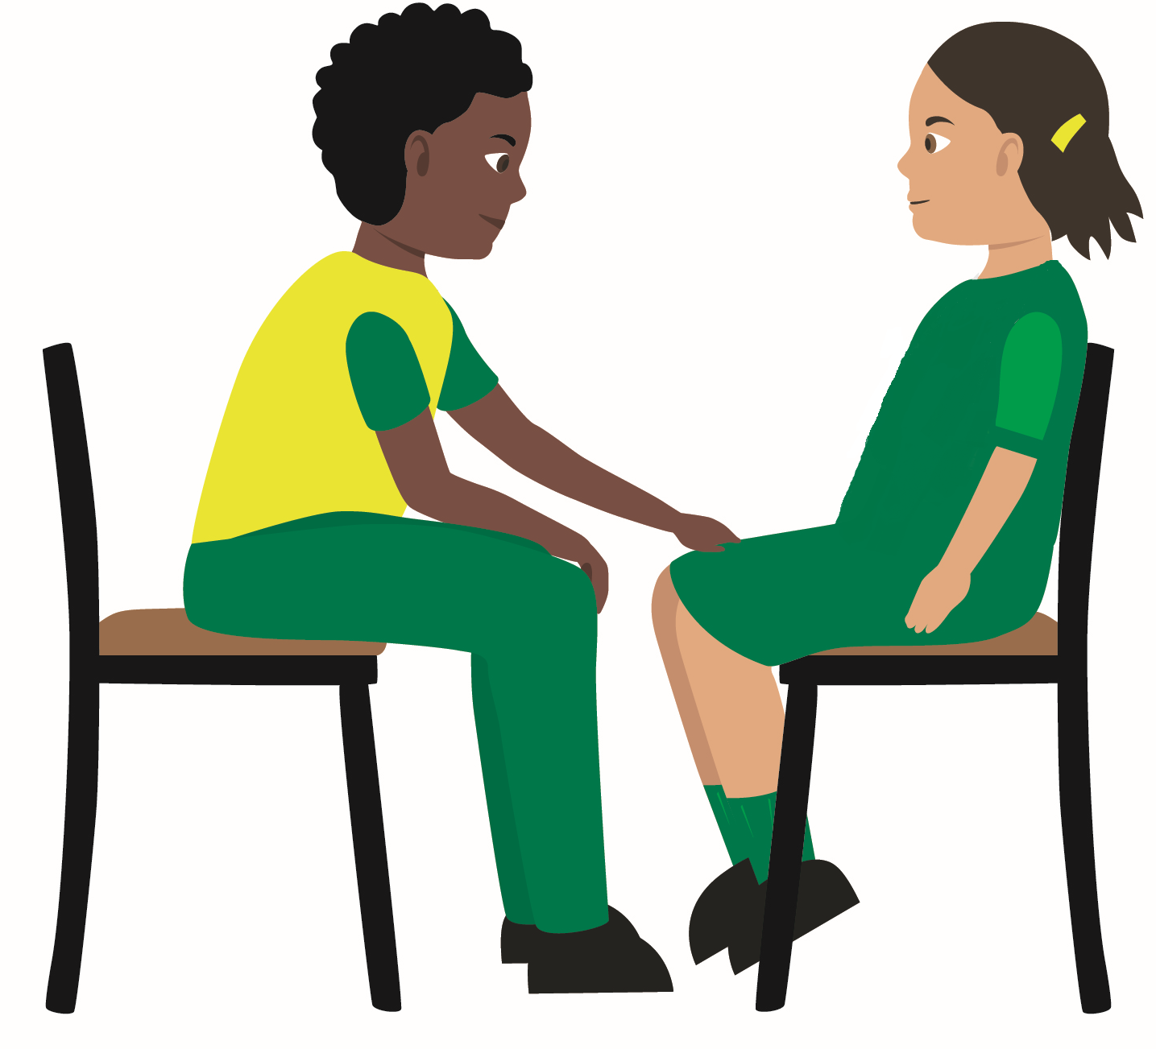
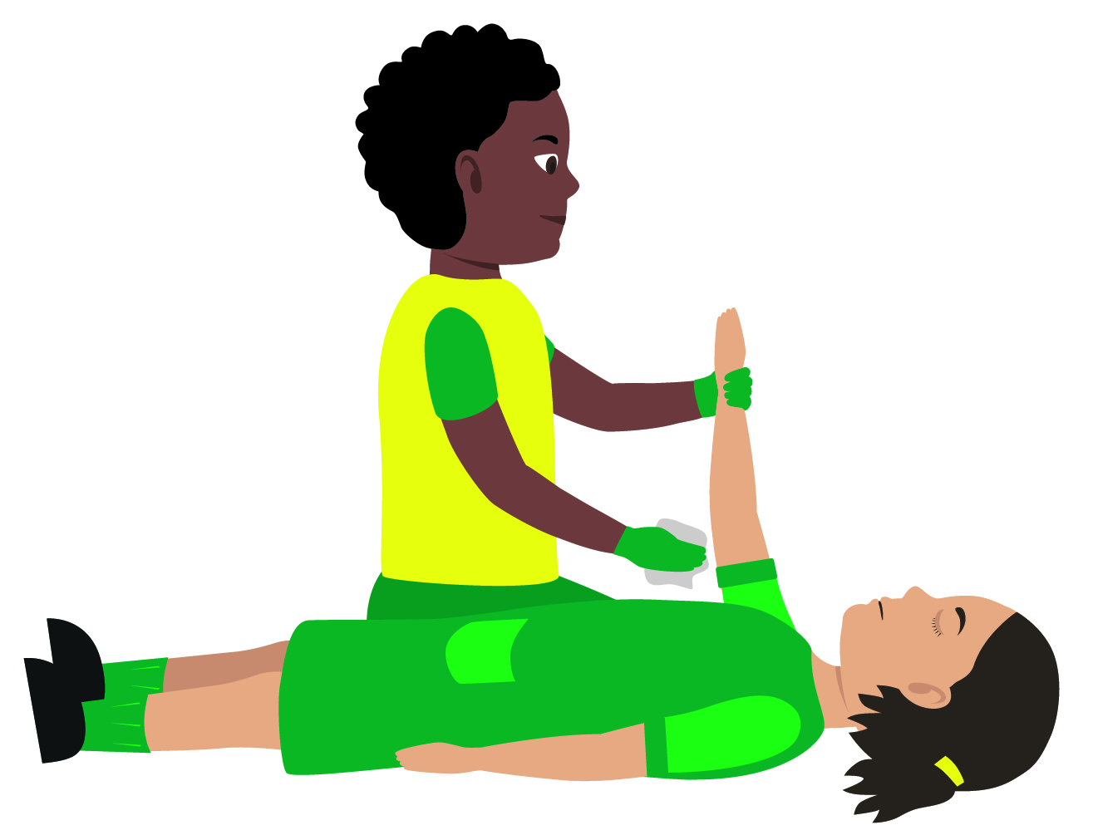
Your turn:
Treating stings
1. Reassure the casualty
Help them to sit or lie down
2. Remove the sting
If a sting is visible, brush or scrape it sideways with the edge of a card or your fingernail
3. Raise affected area
Apply a cold compress to minimise swelling
  Keep cold compress in place for at least 10 minutes.
  Monitor vital signs and watch for signs of an allergic reaction e.g. wheezing and/or itchy, swollen, red skin
Call 999 or 112
If casualty shows signs of severe allergic reaction
Remember: Your casualty could become unresponsive. Be prepared to perform CPR
Notes:
Scenario cards are available which the teacher can use to make the practical activity relevant in a certain context for students.
In pairs/ small group demo management of an insect bite or sting.

Slide 15
Your turn:
Treating tick bites
1. Reassure the casualty
Help them to sit or lie down
2. Remove the tick
Using tweezers, grasp ticks head as close to casualty’s skin as you can
3. Gently pull head upwards
Using steady even pressure.
Do not jerk the tick as it may leave the mouth parts embedded
  4. Save the tick
  Keep the tick for identification
  Place it in a sealed plastic bag and give to the casualty
Seek medical advice
The casualty should take the tick with them as it may be required for analysis
Notes:
Scenario cards are available which the teacher can use to make the practical activity relevant in a certain context for students.
In pairs/ small group demo management of an insect bite or sting.

Slide 16
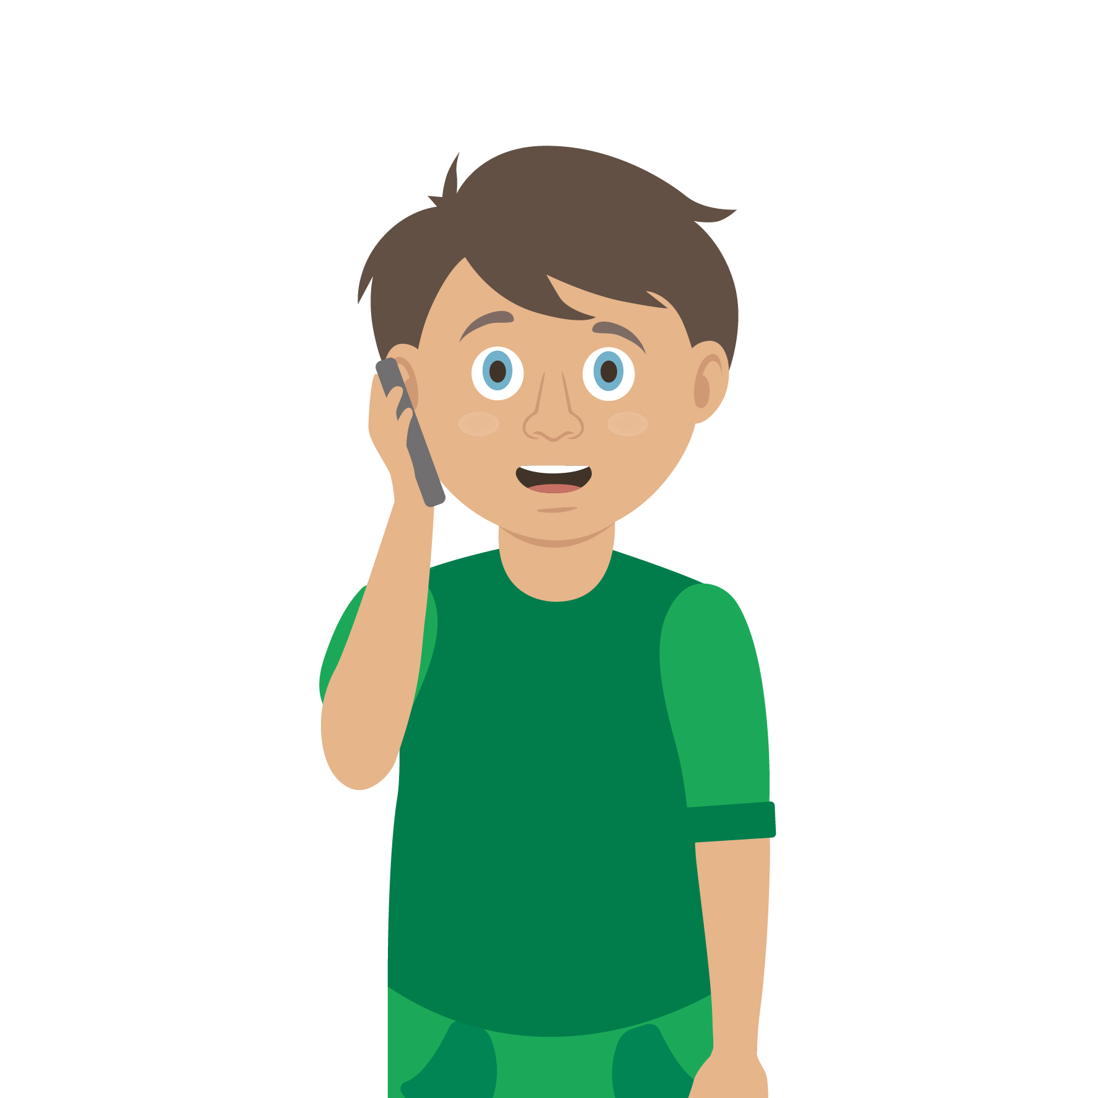
Casualty care
Pause for thought...
Which actions do you think are most important when caring for a casualty?
Get help
No food or drink
Prevent condition worsening
Remain calm
Keep warm
Treat with dignity and respect
Reassure casualty
Communicate well
Notes:
Opportunity to discuss common casualty care skills which are necessary in all first aid situations.

Slide 17




Check your learning
I am able to:
Identify when someone is having an allergic reaction to a bite or a sting
Give first aid for a bite or a sting
Call for help correctly, if it is necessary
YES NO

Slide 18

Information and support
If any of the content in this session has upset or concerned you please discuss this with one of the teachers at your school
Further support can be found at:
www.childline.org.uk
www.youngminds.org.uk
www.samaritans.org
Further information linked to first aid can be found at:
www.sja.org.uk
www.asthma.org.uk

Slide 19

Thank you!

Slide 20


Activity A20
Bites and stings charades
I may sting!
I may bite!
Notes:
Activity – Ask the children to split in to small groups/pairs. Get them both to act out something that could bite or sting – their partner/group has to guess what they are. The children should try to come up with different charades from their peers. The content of the page is examples of something they could choose.

Slide 21
Activity A21
Causes of a bite injury
1. Bite from a _____________­­­­___
The injury could be mild / severe * because…
_______________________________________________________________________________________________________________________________________________
*circle as appropriate
5. Bite from a _____________­­­­___
The injury could be mild / severe * because…
_______________________________________________________________________________________________________________________________________________
*circle as appropriate
2. Bite from a _____________­­­­___
The injury could be mild / severe * because…
_______________________________________________________________________________________________________________________________________________
*circle as appropriate
5 things that could give you a bite injury
4. Bite from a _____________­­­­___
The injury could be mild / severe * because…
_______________________________________________________________________________________________________________________________________________
*circle as appropriate
3. Bite from a _____________­­­­___
The injury could be mild / severe * because…
_______________________________________________________________________________________________________________________________________________
*circle as appropriate

Slide 22
Your turn:
Treating bites
1. Reassure the casualty
Help them to sit or lie down
2. Clean
Wash the wound thoroughly with soap and water to minimise the risk of infection
3. Raise and Support the wound
Then pat dry with clean gauze swabs
4. Cover bite
Use a sterile wound dressing
5. Extra help
If the wound is large or deep arrange for the casualty to be taken to hospital
For other bites that pierce the skin seek medical advice
Notes:
In pairs/ small group demo management of an animal/human bite

Slide 23
Your turn:
Treating stings
1. Reassure the casualty
Help them to sit or lie down
2. Remove the sting
If a sting is visible, brush or scrape it sideways with the edge of a card or your fingernail
3. Raise affected area
Apply a cold compress to minimise swelling
  Keep cold compress in place for at least 10 minutes.
  Monitor vital signs and watch for signs of an allergic reaction e.g. wheezing and/or itchy, swollen, red skin
Call 999 or 112
If casualty shows signs of severe allergic reaction
Remember: Your casualty could become unresponsive. Be prepared to perform CPR
Notes:
In pairs/ small group demo management of an insect bite or sting.

Slide 24
Your turn:
Treating tick bites
1. Reassure the casualty
Help them to sit or lie down
2. Remove the tick
Using tweezers, grasp ticks head as close to casualty’s skin as you can
3. Gently pull head upwards
Using steady even pressure.
Do not jerk the tick as it may leave the mouth parts embedded
  4. Save the tick
  Keep the tick for identification
  Place it in a sealed plastic bag and give to the casualty
Seek medical advice
The casualty should take the tick with them as it may be required for analysis
Notes:
In pairs/ small group demo management of an insect bite or sting.

