Slide 1

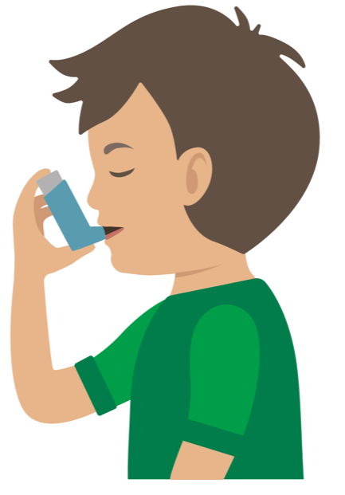
Starter Activity
4 steps to help someone having an asthma attack
Step 1.
Step 2.
Number the images to show which step they belong to
Step 3.
Step 4.
Use your current first aid knowledge to explain what you could do for each of the 4 steps.
Remember: Your casualty could become unresponsive. Be prepared to perform CPR.
Notes:
S and C version

Slide 2
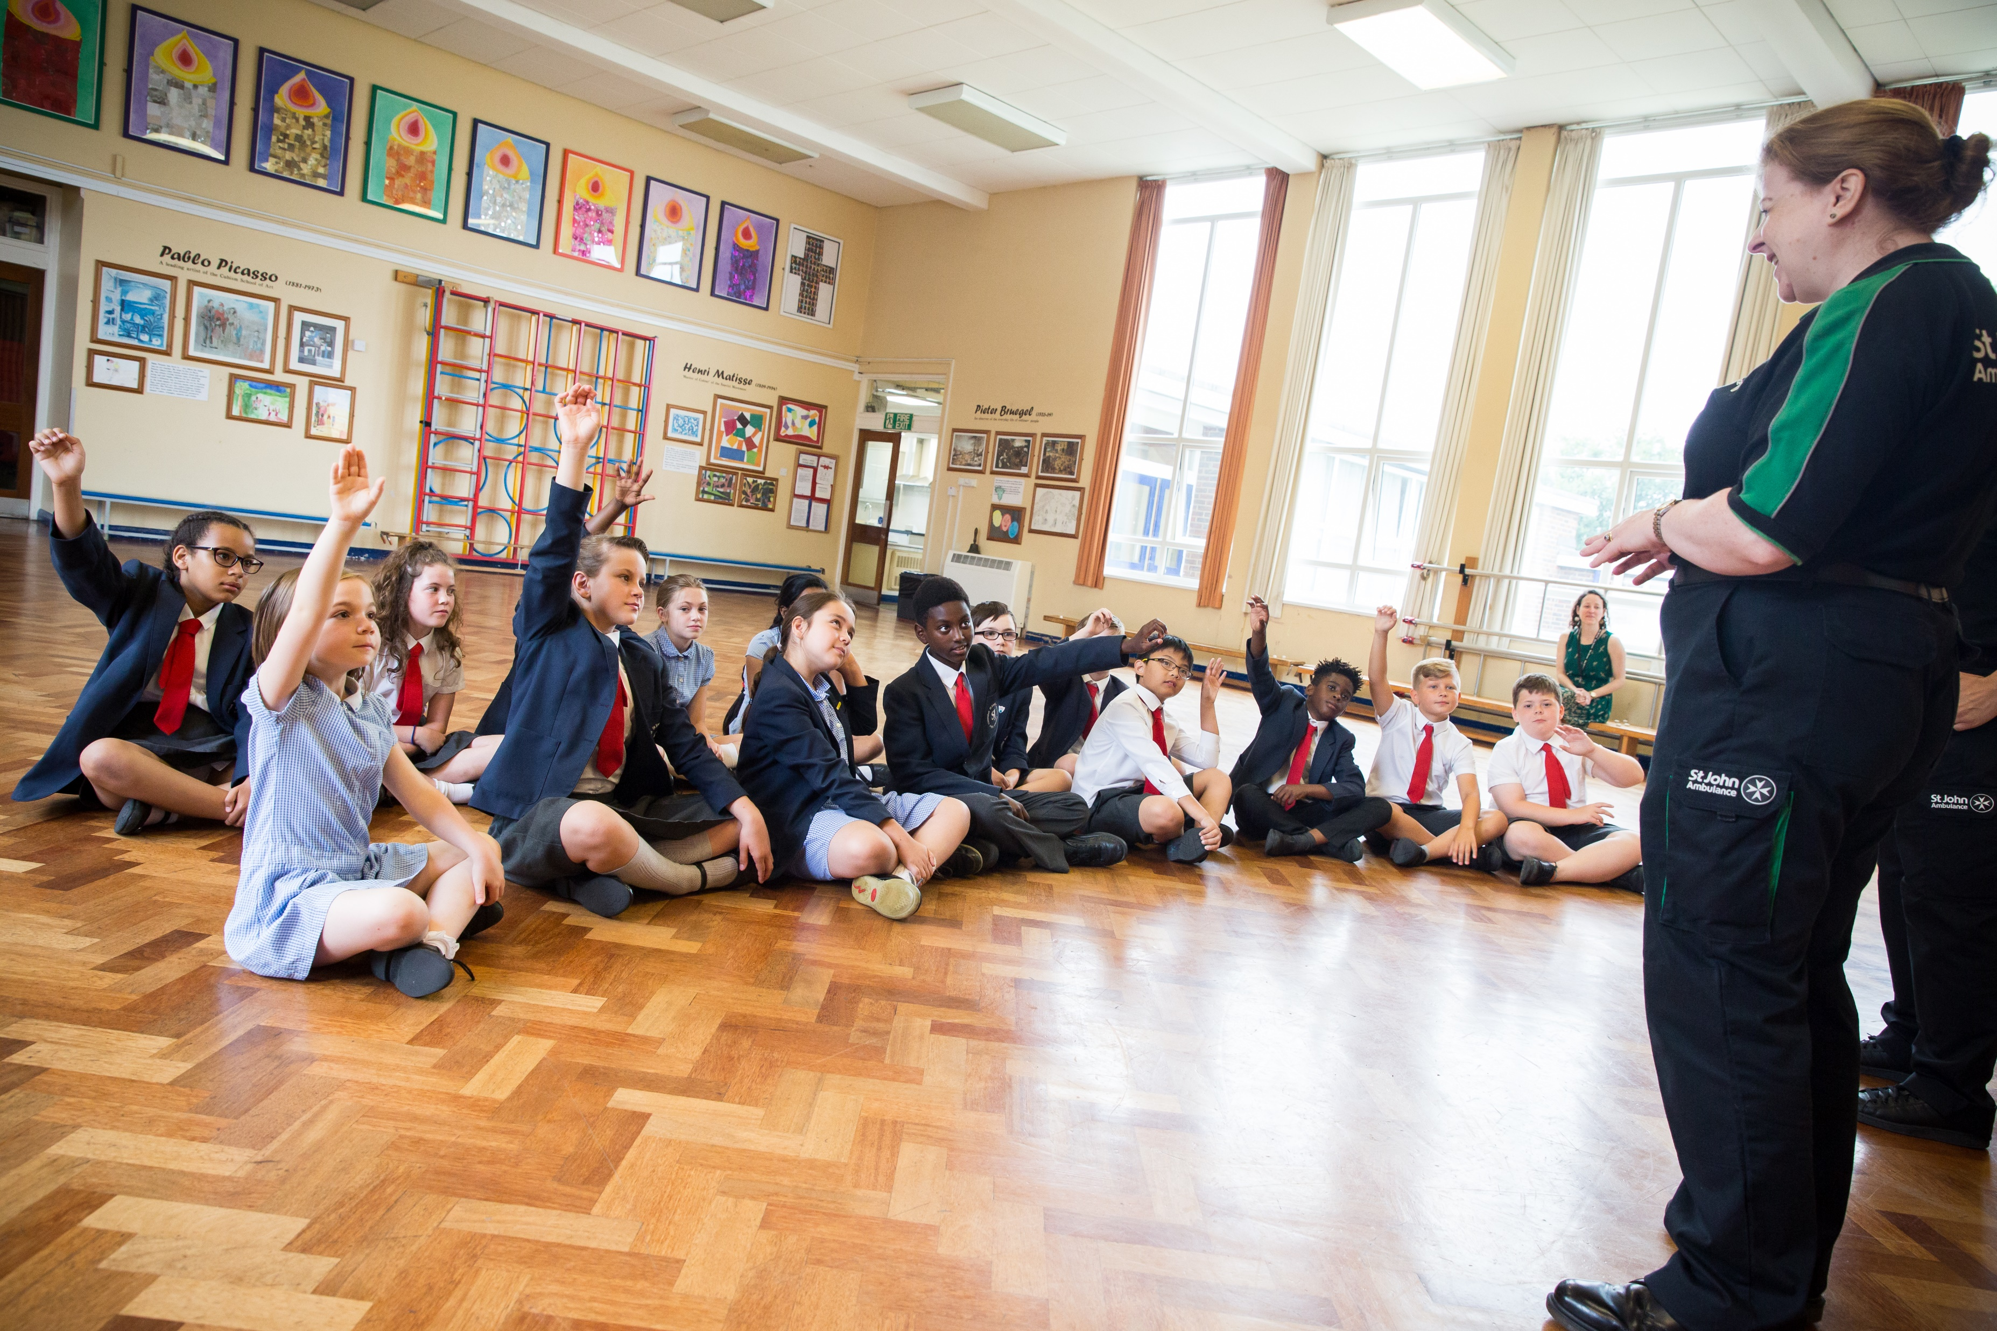


Asthma

Slide 3

Asthma
A short course to learn how to help someone who is having difficulty breathing due to asthma.
KS2 - Asthma

Slide 4
Learning outcomes
I can identify a casualty who is having an asthma attack
I can assess a casualty’s condition calmly and I can give first aid to someone who is having difficulty breathing due to asthma
I can seek medical help, if required, for someone who is having an asthma attack
Notes:
Teacher should refer to ground rules for the session at this stage

Slide 5
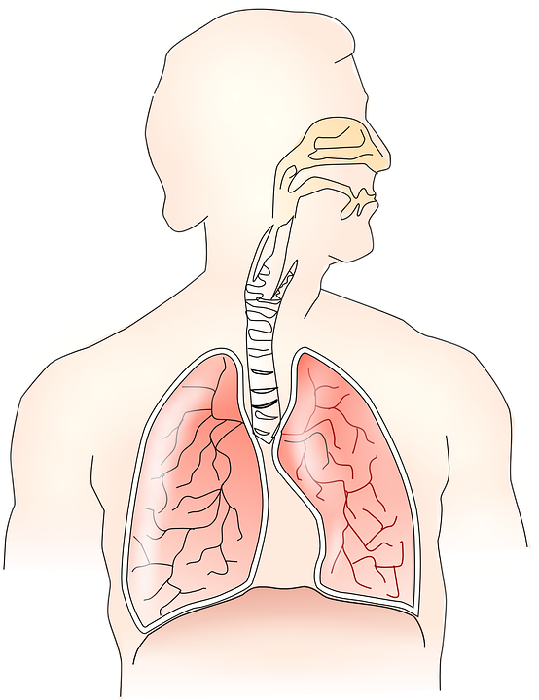
Asthma
Basic anatomy
We breathe air into our body through our MOUTH and N_ _ _.
This air needs to travel down into our LUNGS.
During an A_ _ _ _ _ attack the muscles of the air passages can go into spasm and this causes the passages to narrow which makes breathing difficult.
Sometimes there is a trigger that can cause this to happen.
Notes:
ANS; NOSE and ASTHMA
Explain trigger is something that sets off an asthma attack.

Slide 6
Activity A6
This activity provides students with the opportunity to construct a basic model of the airways and lungs. If you wish to complete this, please go to slide 16 or use our downloadable worksheet (A6) found on the St John Ambulance website.
Notes:
Note – This is an additional activity

Slide 7

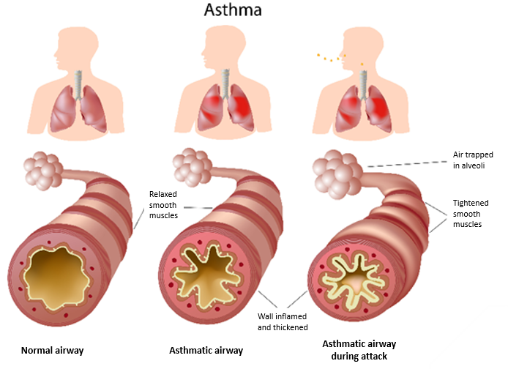
What do you see?
Notes:
To note is the narrowing of the airways in the asthma airway. Explain we breathe in through mouth and nose and air goes down into lungs where it gives body the oxygen it needs to survive. Asthma airways are congested with mucous etc and make it narrow and harder to breathe.

Slide 8

Asthma A8
What do you think?
Signs and symptoms of someone having an asthma attack could be…
A SYMPTOM is something that the casualty tells you they feel.
A SIGN is something you can see.
Notes:
Write answers onto white board ready for next slide to compare.

Slide 9
Answers A8
Signs and symptoms of asthma could be:
difficulty breathing
wheezing
difficulty speaking, leading to short sentences
coughing
distress and anxiety
grey/blue tinge to lips
exhaustion
loss of responsiveness
panic
rapid heart rate
Question:
What action should be taken if somebody is displaying these signs or symptoms?
Explain your answer.

Slide 10
Watch this video
https://youtu.be/YePRdtYpMwQ

Slide 11
Activity A9
You now have the chance to complete a group activity. This will test what students have learnt so far. If you wish to complete this, please go to slides 17 and 18 of this presentation.

Slide 12

Your turn
Asthma attack
Help the casualty to sit down
Reassure them
Encourage slow breaths
2. Assist them to use their reliever inhaler
Casualty can take one or two puffs every two minutes
Maximum 10 puffs
A mild attack should ease in a few minutes
4. Reassure casualty
Stay with them until the ambulance arrives
Remember: Your casualty could become unresponsive. Be prepared to perform CPR.
3. Call 999/112 if attack is not easing
Notes:
Scenario cards are available which the teacher can use to make the practical activity relevant in a certain context for students.
In pairs/ small group demo management of an asthma attack

Slide 13

Casualty care
Pause for thought...
Which actions do you think are most important when caring for a casualty?
Get help
No food or drink
Prevent condition worsening
Remain calm
Keep warm
Treat with dignity and respect
Communicate well
Reassure casualty
Notes:
Opportunity to discuss common casualty care skills which are necessary in all first aid situations.

Slide 14


Check your learning
I am able to:
Identify when someone is having difficulty breathing due to asthma
Give first aid to a casualty who is having an asthma attack
Call for help correctly, if it is necessary
YES NO

Slide 15

Information and support
If any of the content in this session has upset or concerned you please discuss this with one of the teachers at your school
Further support can be found at:
www.childline.org.uk
www.youngminds.org.uk
www.samaritans.org
Further information linked to first aid can be found at:
www.sja.org.uk
www.asthma.org.uk

Slide 16

Thank you!

Slide 17
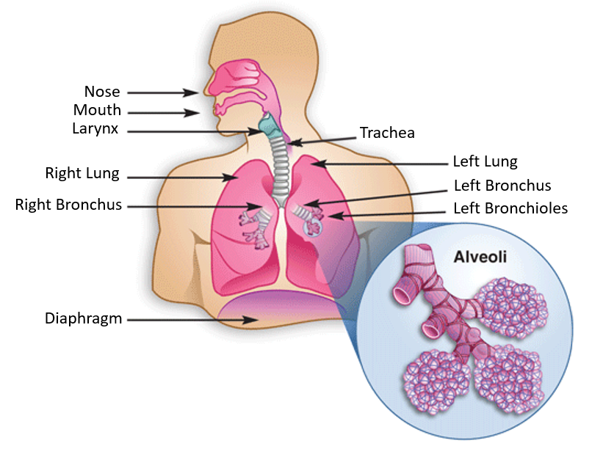
Optional activity A6
Asthma
Making paper lungs
YOU WILL NEED:
2 paper bags, 2 straws, marker pen(s), sticky tape, scissors, activity sheet A6 and diagram of respiratory system.
TASK:
Follow the instructions on the activity worksheet A6 to make paper lungs.
QUESTION:
What happens if the straw is:
1. longer
2. shorter
3. narrower
Notes:
Look at different length of straws and width- how does this affect ability to blow up paper lungs?

Slide 18
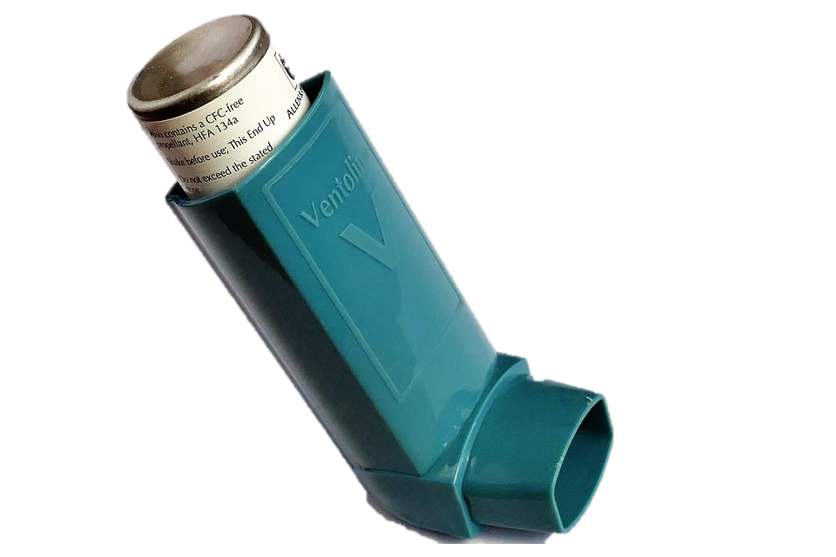
Activity A9
Group work
DISCUSS:
Describe how it may feel when someone is having difficulty breathing?
QUESTION:
What could be done to help someone who is having an asthma attack?
BONUS QUESTION A9a:
What are possible triggers for an asthma attack?
(something that makes an asthma attack happen)
Notes:
Triggers: pet hair, cold air, exercise, pollution, cigarette smoke, allergy etc

Slide 19
Asthma triggers
A9a
How many of these answers did you get?
Pollen
Pollution
2
3
Pet fur
Aerosols
2
3
Smoking
1
Exercise
Cold Air
2
3
Cleaning solutions
Total:
1

