Slide 1
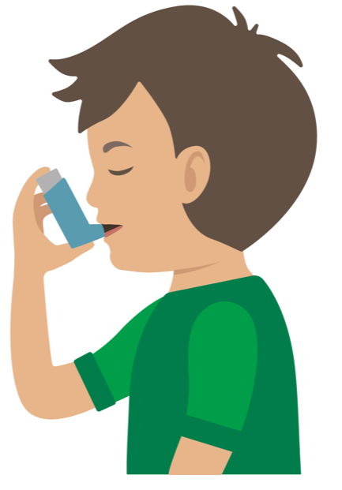

Your turn
Asthma attack
Help the casualty to sit down
Reassure them
Encourage slow breaths
2. Assist them to use their reliever inhaler
Casualty can take one or two puffs every two minutes
Maximum 10 puffs
A mild attack should ease in a few minutes
4. Reassure casualty
Stay with them until the ambulance arrives
Remember: Your casualty could become unresponsive. Be prepared to perform CPR.
3. Call 999/112 if attack is not easing
Notes:
In pairs/ small group demo management of an asthma attack

