Slide 1
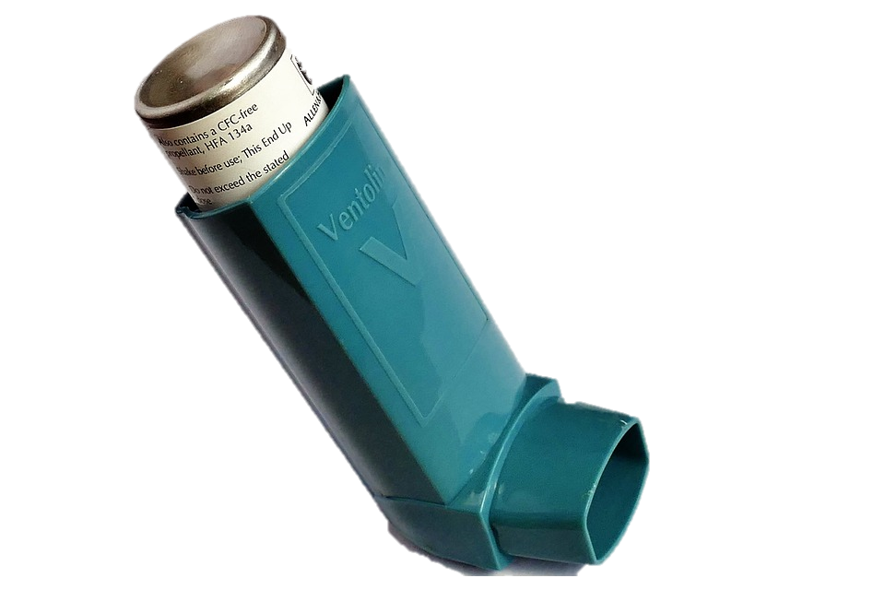
Activity A9
Group work
DISCUSS:
Describe how it may feel when someone is having difficulty breathing
QUESTION:
What could you do to help someone who is having an asthma attack?
BONUS QUESTION A9a:
What are possible triggers for an asthma attack? (something that makes an asthma attack happen)
Notes:
Triggers: pet hair, cold air, exercise, pollution, cigarette smoke, allergy etc

Slide 2
Asthma triggers
A9a
How many of these answers did you get?
Pollen
Pollution
2
3
Pet fur
Aerosols
2
3
Smoking
1
Exercise
Cold Air
2
3
Cleaning solutions
Total:
1

