Slide 1
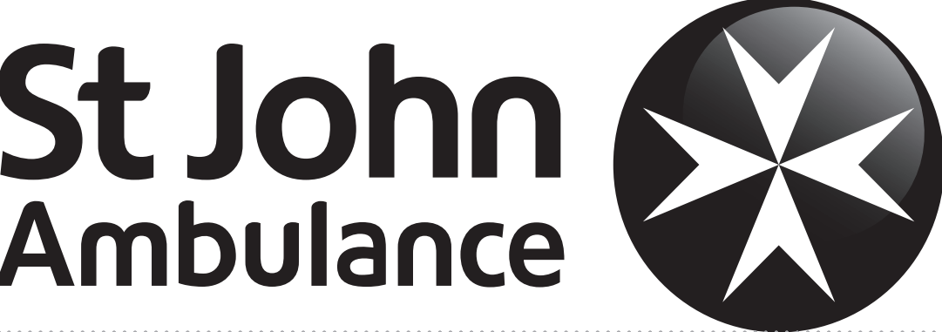

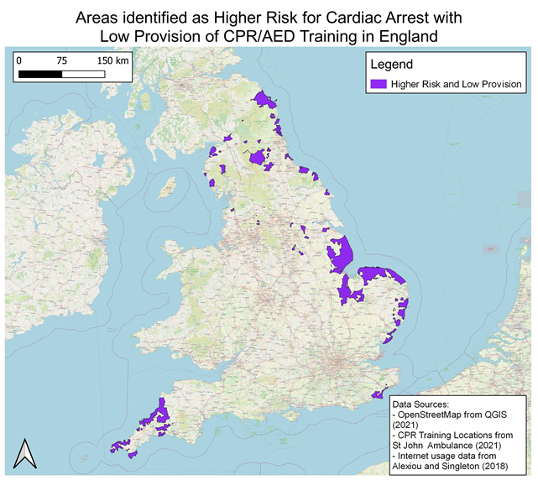





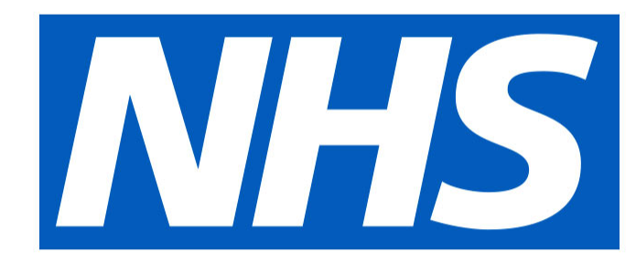



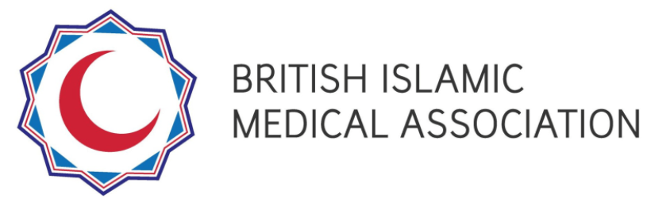



National Coordination of First Response Project
Public name
for project
once decided
AIMS OF THE PROJECT
Undertake a review of the existing provision
Improve the awareness of use of defibrillators
Increase the number of new people trained in CPR
Support partners and volunteers in co-ordinating an enhanced training offer in relation to ventilation free CPR plus risk consideration and mitigation in relation to CPR training with ventilation.
Gap Analysis completed
Resource bank developed
Targeted recruitment in progress
KPIs finalised for rest of project
Comms and social media campaigning to start
CA VIRTUAL PUBLIC SESSION CALENDER
EVERYDAY FIRST AID
Tues 22nd March – 7-8:30pm
Thurs 28th April -7-8:30pm
Tues 24th May – 7-8:30pm
Thurs 23rd June -7-8:30pm
EMERGENCY FIRST AID
Thurs 24th March -7-8:30pm
Tues 26th April – 7-8:30pm
Thurs 26th May -7-8:30pm
Tues 21st June – 7-8:30pm
OBJECTIVES
Recruit 300 Community Advocates in England – to
deliver free awareness sessions on CPR and AED use to community groups, referring on to further training as
needed.
Form a steering group of training partners – to act on the information provided by the gap analysis and enable
more communities to engage with CPR and AED training
to save lives.
Identify communities in need of these sessions, working
together to improve provision in these areas
Create resources to support communities to engage with
CPR and AED skills
Track confidence of people attending sessions to act in
the event of a cardiac arrest, to understand how long this confidence lasts.
UPCOMING GROUP SESSIONS
COMMUNITY ADVOCATE (CA) VOLUNTEER ROLE
London
Isle of Wight
St Leonards-on-Sea
Raise awareness of the importance of CPR/AED skills through engagement with targeted communities (e.g. adult support groups, places, of worship groups, community centre groups)
Provide CPR and AED knowledge to local community groups and associations through two 1.5 hour sessions a month
Training, access to a variety of online materials and resources will be provided
If you are interested in becoming a Community Advocate or would like to find out more about the role, please contact the Community Engagement team of St John Ambulance on Community.Engagement@sja.org.uk.
USEFUL LINKS
https://www.sja.org.uk/get-advice/national-coordination-of-first-response/
https://www.thecircuit.uk/
https://www.resus.org.uk/
https://www.bhf.org.uk/revivr

